Slide 1


Healthcare is just for Biologists, right?
Scan QR code to join Mentimeter poll and answer the first question (if presentation is being delivered by University of Birmingham staff)
James White
School of Chemical Engineering
University of Birmingham
Notes:
If this presentation is being delivered by a teacher, an alternative to using menti meter is to ask the three questions that are outlined on these slides and in the speaker notes
Slide 1:
Healthcare is just for biologists, right?
Show of hands for yes
Show of hands for no

Slide 2
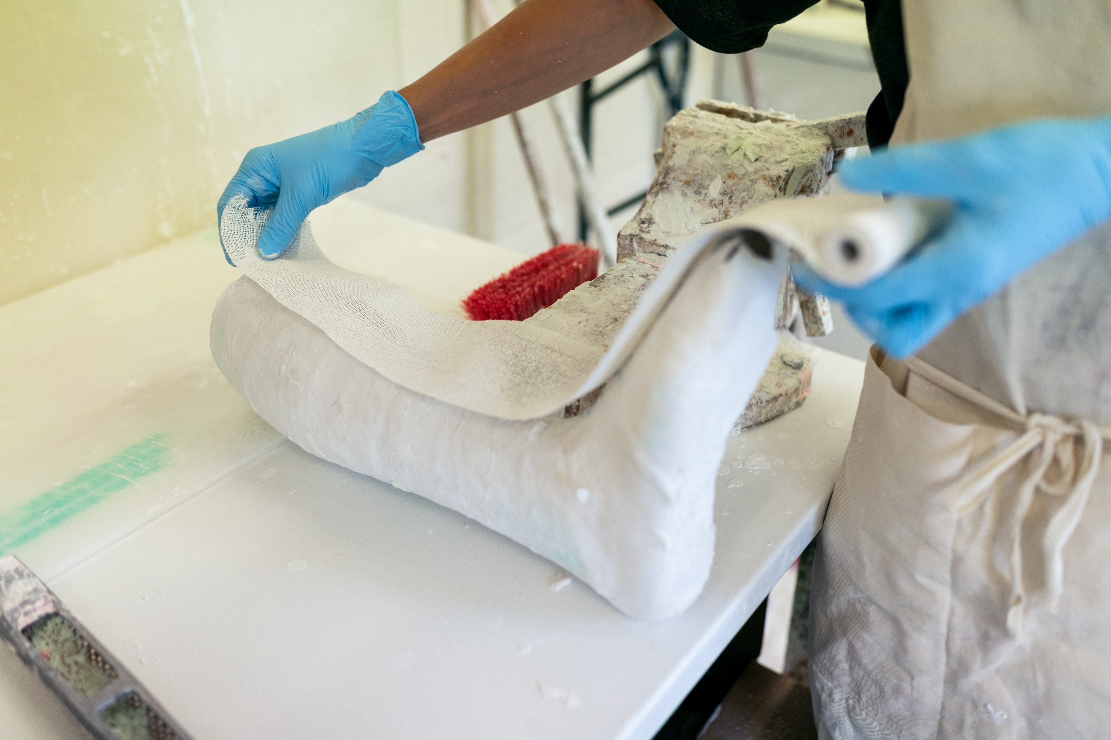

Wrong!
To develop a new drug, vaccine or treatment a wide range of expertise will be required.
  Expertise could include:
    Chemical Engineers
    Chemists
    Biologists
    Bio-medics
    Clinicians
    Lawyers
    Accountants
    Marketing Teams
    And many more ..
Notes:
Ask the group to name as many disciplines involved in drug development as they can, before revealing the bullet point list of suggested answers.

Slide 3
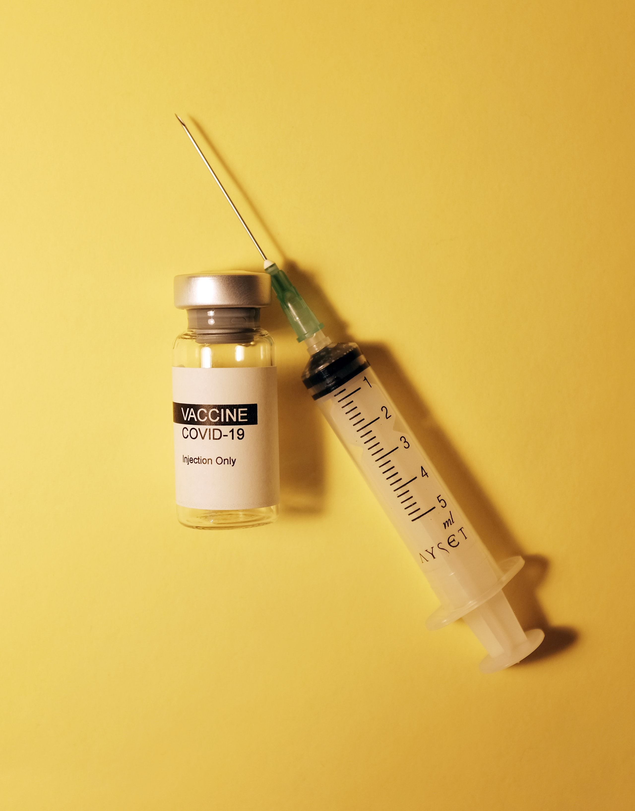
Drug Development Process
A drug is a chemical or biological substance that has some physiological or biochemical effect on the body
Can take 10-15 years for a drug to go from development to market
This process will cost around £500 million
A very difficult process with a low success rate

Slide 4
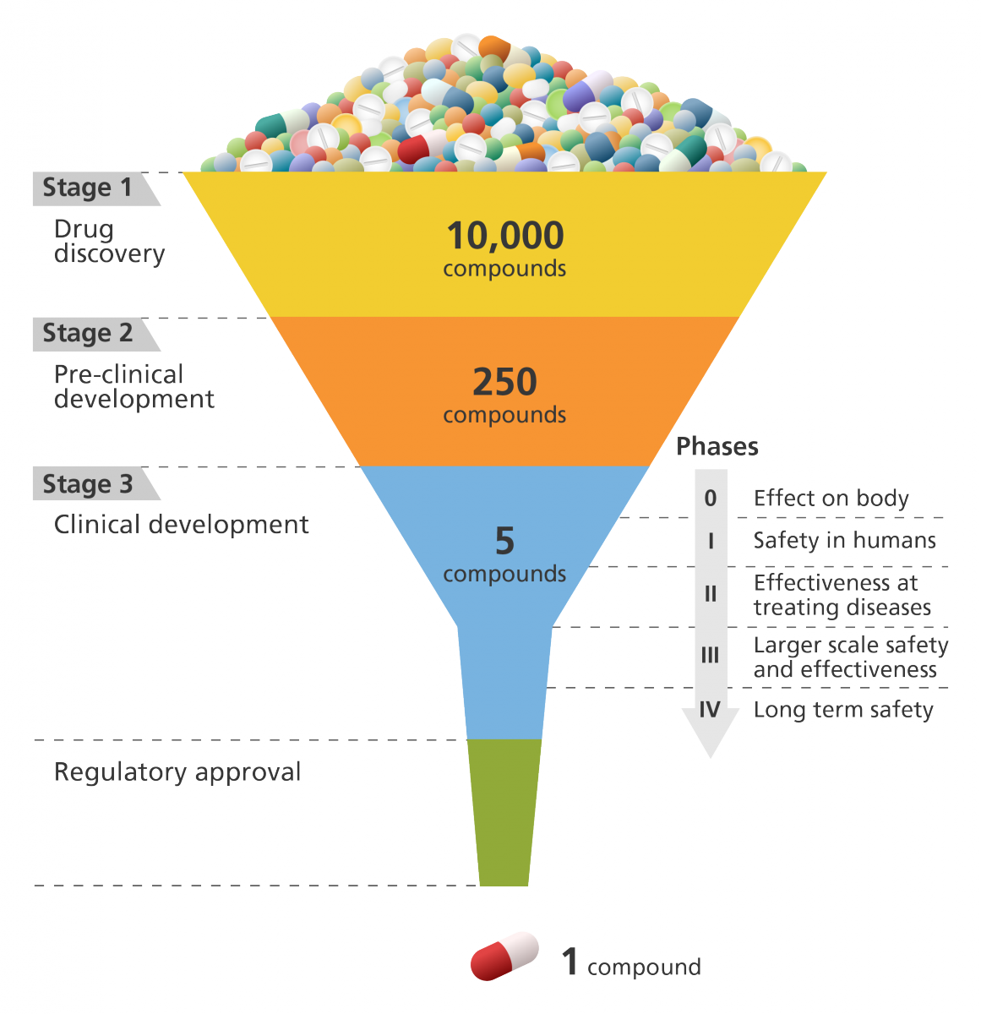
The four stages of drug development
Stage 1: Drug Discovery
Stage 2: Pre-clinical development
Stage 3: Clinical development
  Phase 0: Effect on body
  Phase 1: Safety in humans
  Phase 2: Effectiveness at treating diseases
  Phase 3: Larger scale safety and effectiveness
  Phase 4: Long term safety
Regulatory approval
Diagram from Genome Research Limited

Slide 5
Stage 1: Drug Discovery
Often takes place in universities
Many compounds are tested to see if they have any therapeutic effect
The target compound must be successful at treating the disease, safe, usable and capable of meeting clinical and commercial requirements
Once a group of target compounds have been found, a series of experiments are conducted to find out more about the compound .
  E.g.
  Dosage - Side effects
  Method of delivery - Interactions with other drugs

Slide 6
Stage 2: Preclinical Research
This focuses on the drug’s toxicity and whether it will be safe to consume
This is done with in vivo and in vitro methods:
  In vivo – Uses mice, rats and dogs
  In vitro – Uses laboratory techniques
Usually this stage does not take too long. However, at this point detailed information on dosing and toxicity levels will be produced.
The best delivery method (Oral, Topical, Intravenous, Inhalation) will be further investigated at this stage

Slide 7
Stage 3: Clinical Development
Preclinical research answers basic questions about the drug’s safety, clinical trials are still required to see how the drug will react on people.
To ensure the drug is safe, effective and delivered in the correct quantity, there are four keys phases to Clinical Development

Slide 8
Clinical Development - Phase 1
Who?
20 to 100 healthy volunteers or people with the disease/ condition
How long?
Several months
Why?
Safety and dosage
Approximately 70% of drugs get through this stage

Slide 9
Clinical Development - Phase 2
Who?
Up to several hundred people with the disease / condition
How long?
Several months to 2 years
Why?
Efficiency and side effects
Approximately 33% of drugs get through this stage

Slide 10
Clinical Development - Phase 3
Who?
300 to 3000 people with the disease/ condition
How long?
1 to 4 years
Why?
Treatment success and monitoring of adverse reactions
Approximately 25-30% of drugs get through this stage

Slide 11
Clinical Development - Phase 4
Who?
Several thousand volunteers who have the disease / condition
How long?
Several years
Why?
Safety and effectiveness. Post-market safety monitoring is required after the drug has been approved.

Slide 12
Only 1 in 5000 drugs survive the process to become approved

Slide 13
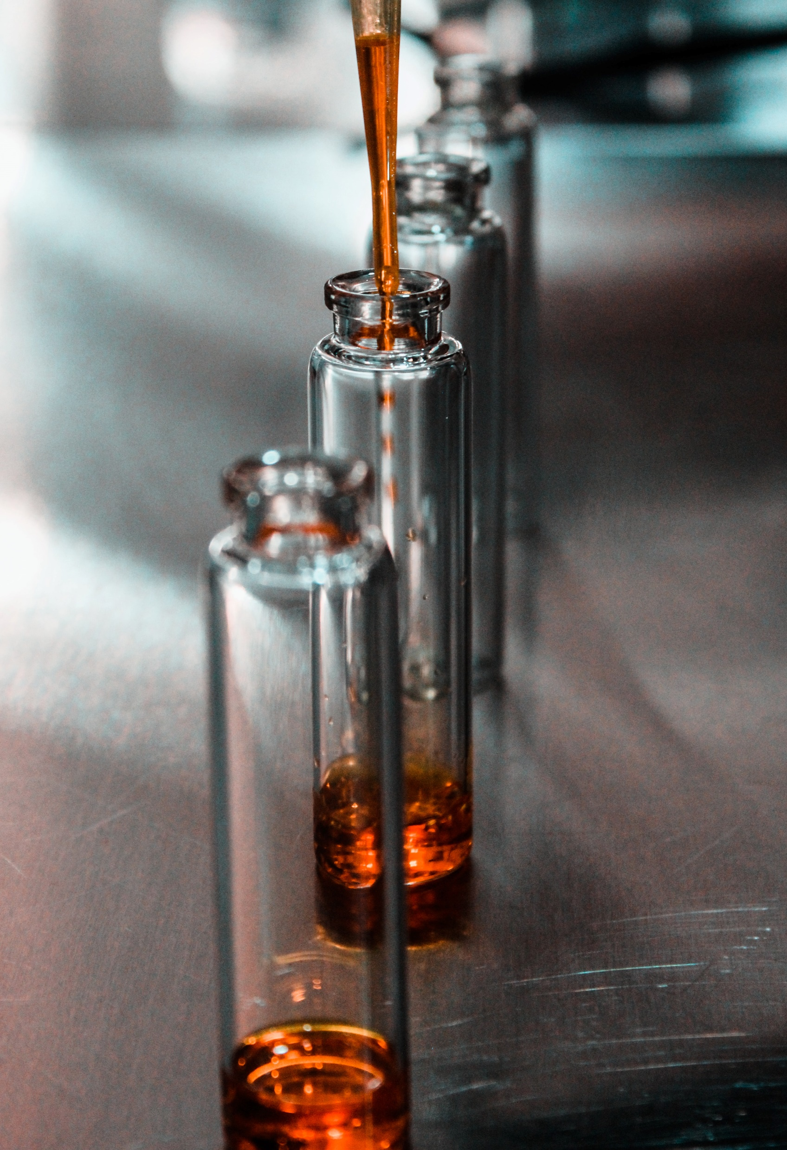
How do we make drugs?
Drugs are made from a complicated chemical synthesis process
This involves techniques such as distillation, reflux, separation and crystallisation
There are large challenges associated with scaling up drug manufacture from test tube scale to mass production

Slide 14
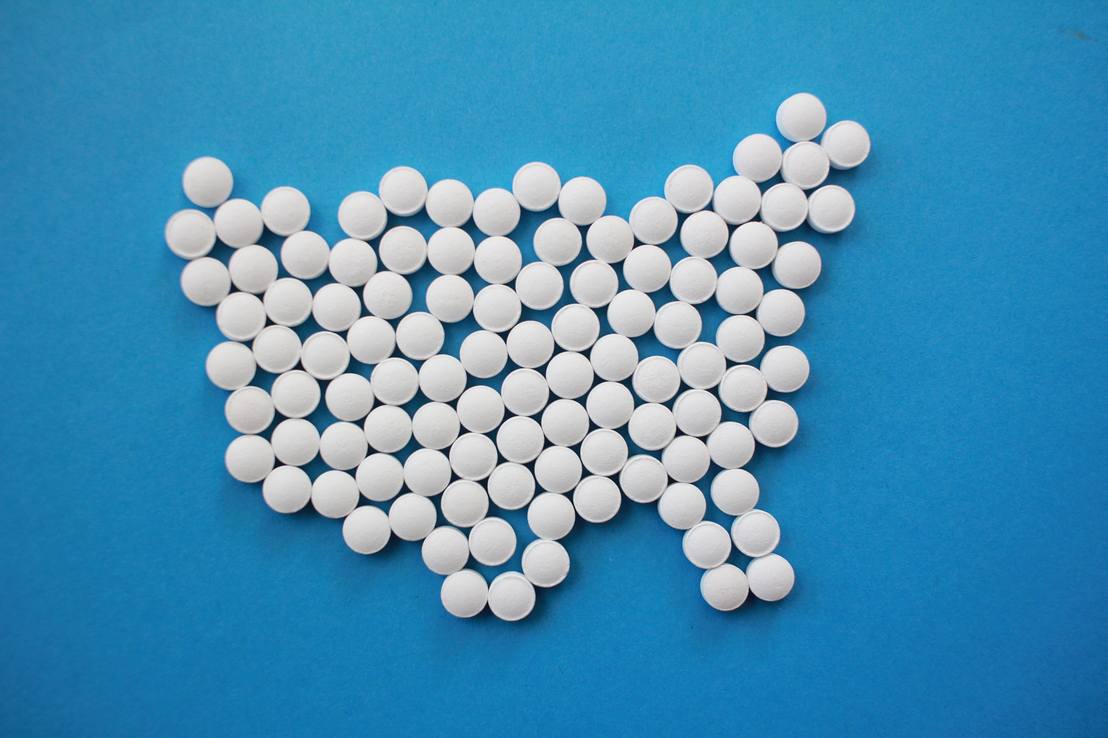
Aspirin
Aspirin is used to reduce pain, fever or inflammation
Further benefits include being a blood thinner
Chemical name is acetylsalicylic acid, C₉H₈O₄
Aspirin can be made by a two stage process starting from the oil of wintergreen
The first stage involves a hydrolysis followed by an esterification process

Slide 15
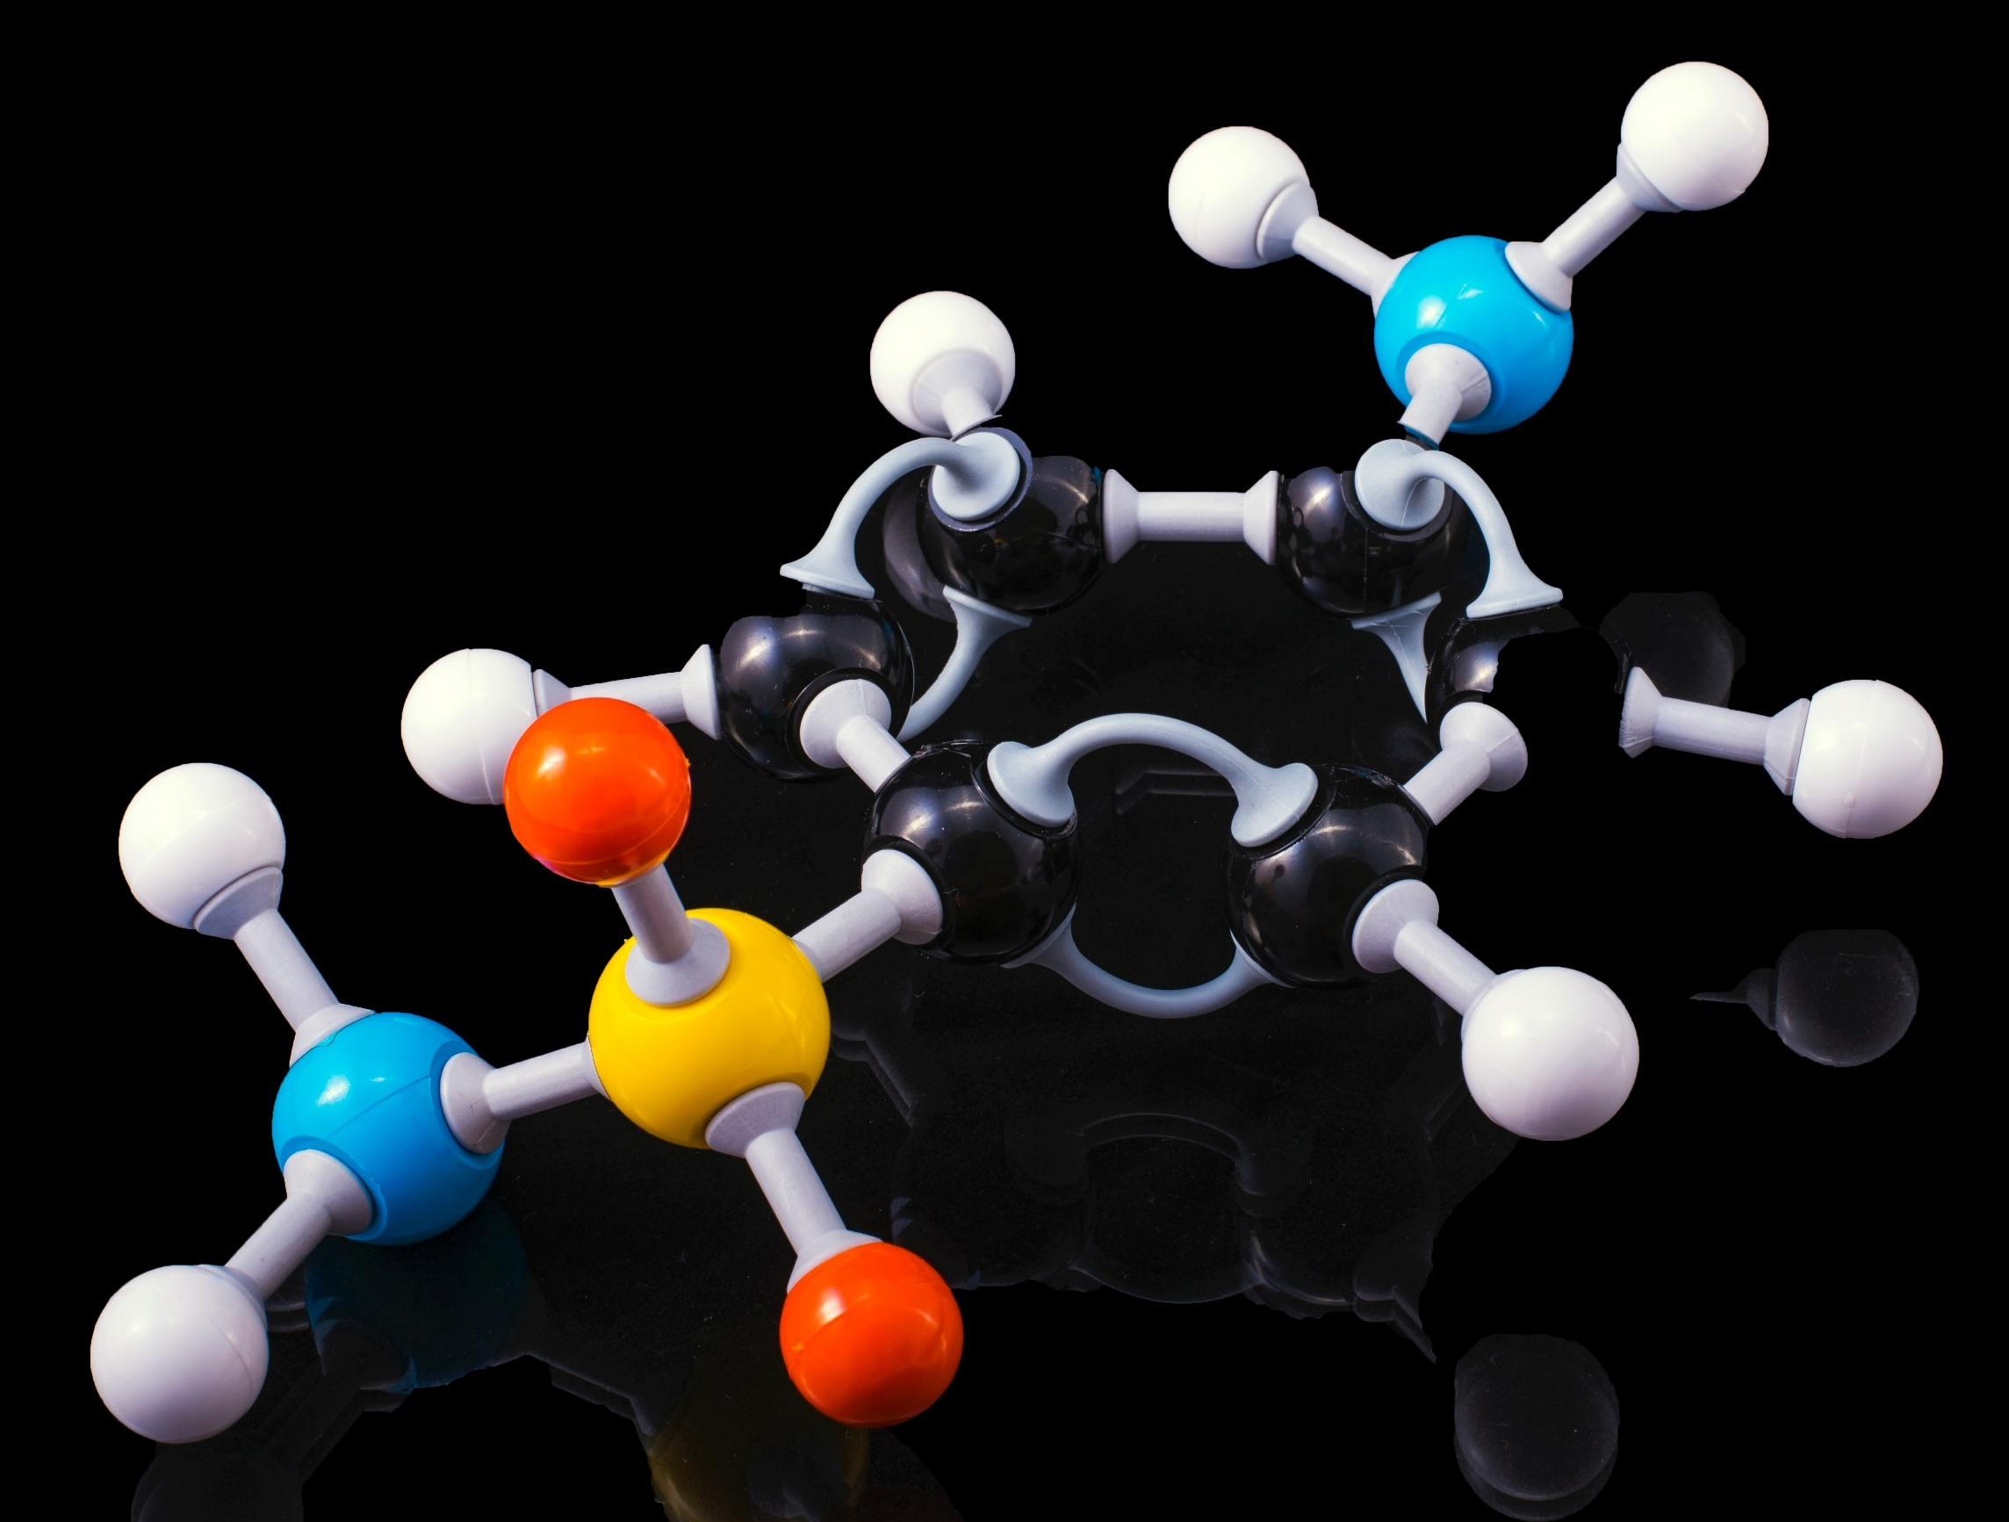
Synthesis of Aspirin
Stage 1 – Preparation of 2-hydroxybenzoic acid
Stage 2 – Preparation of aspirin
Stage 3 – Recrystallisation
Stage 4 – Chromatography
Stage 5 – Melting Point
This process focusses on practical skills to make the aspirin, then testing methods to determine impurities

Slide 16
Stage 1:
Preparation of 2-hydrobenzoic acid

Slide 17
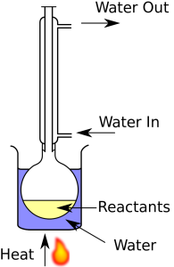
Stage 1 Techniques – Reflux
To speed up the rate of a reaction, the reaction mixture is often heated
However, as many organic compounds have low boiling points this leads to a large volume of the reagents being lost as vapour
A Liebig condenser uses a cold water jacket to condense the vapours so they fall back into the reaction vessel
This means less reagent is lost and a higher product yield is achieved
Diagram from Wikipedia

Slide 18
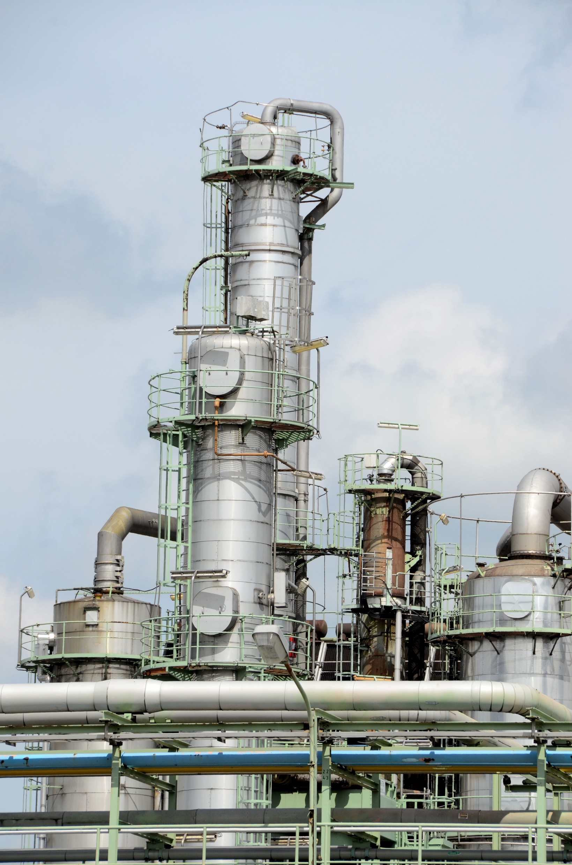
Stage 1 Techniques – Industry Application
Reflux is often used on a very large scale in industry
Distillation is a technique used to separate two fluids by exploiting differences in melting points
Reflux plays a key role in distillation
The reflux ratio determines how much of the vapour is condensed and readded to the distillation column
The size of the column and the required reflux ratio will depend on the fluids that are being separated
This is often utilised in the petrochemical industry to fraction off different grades of crude oil

Slide 19
Stage 2:
Preparation of aspirin

Slide 20
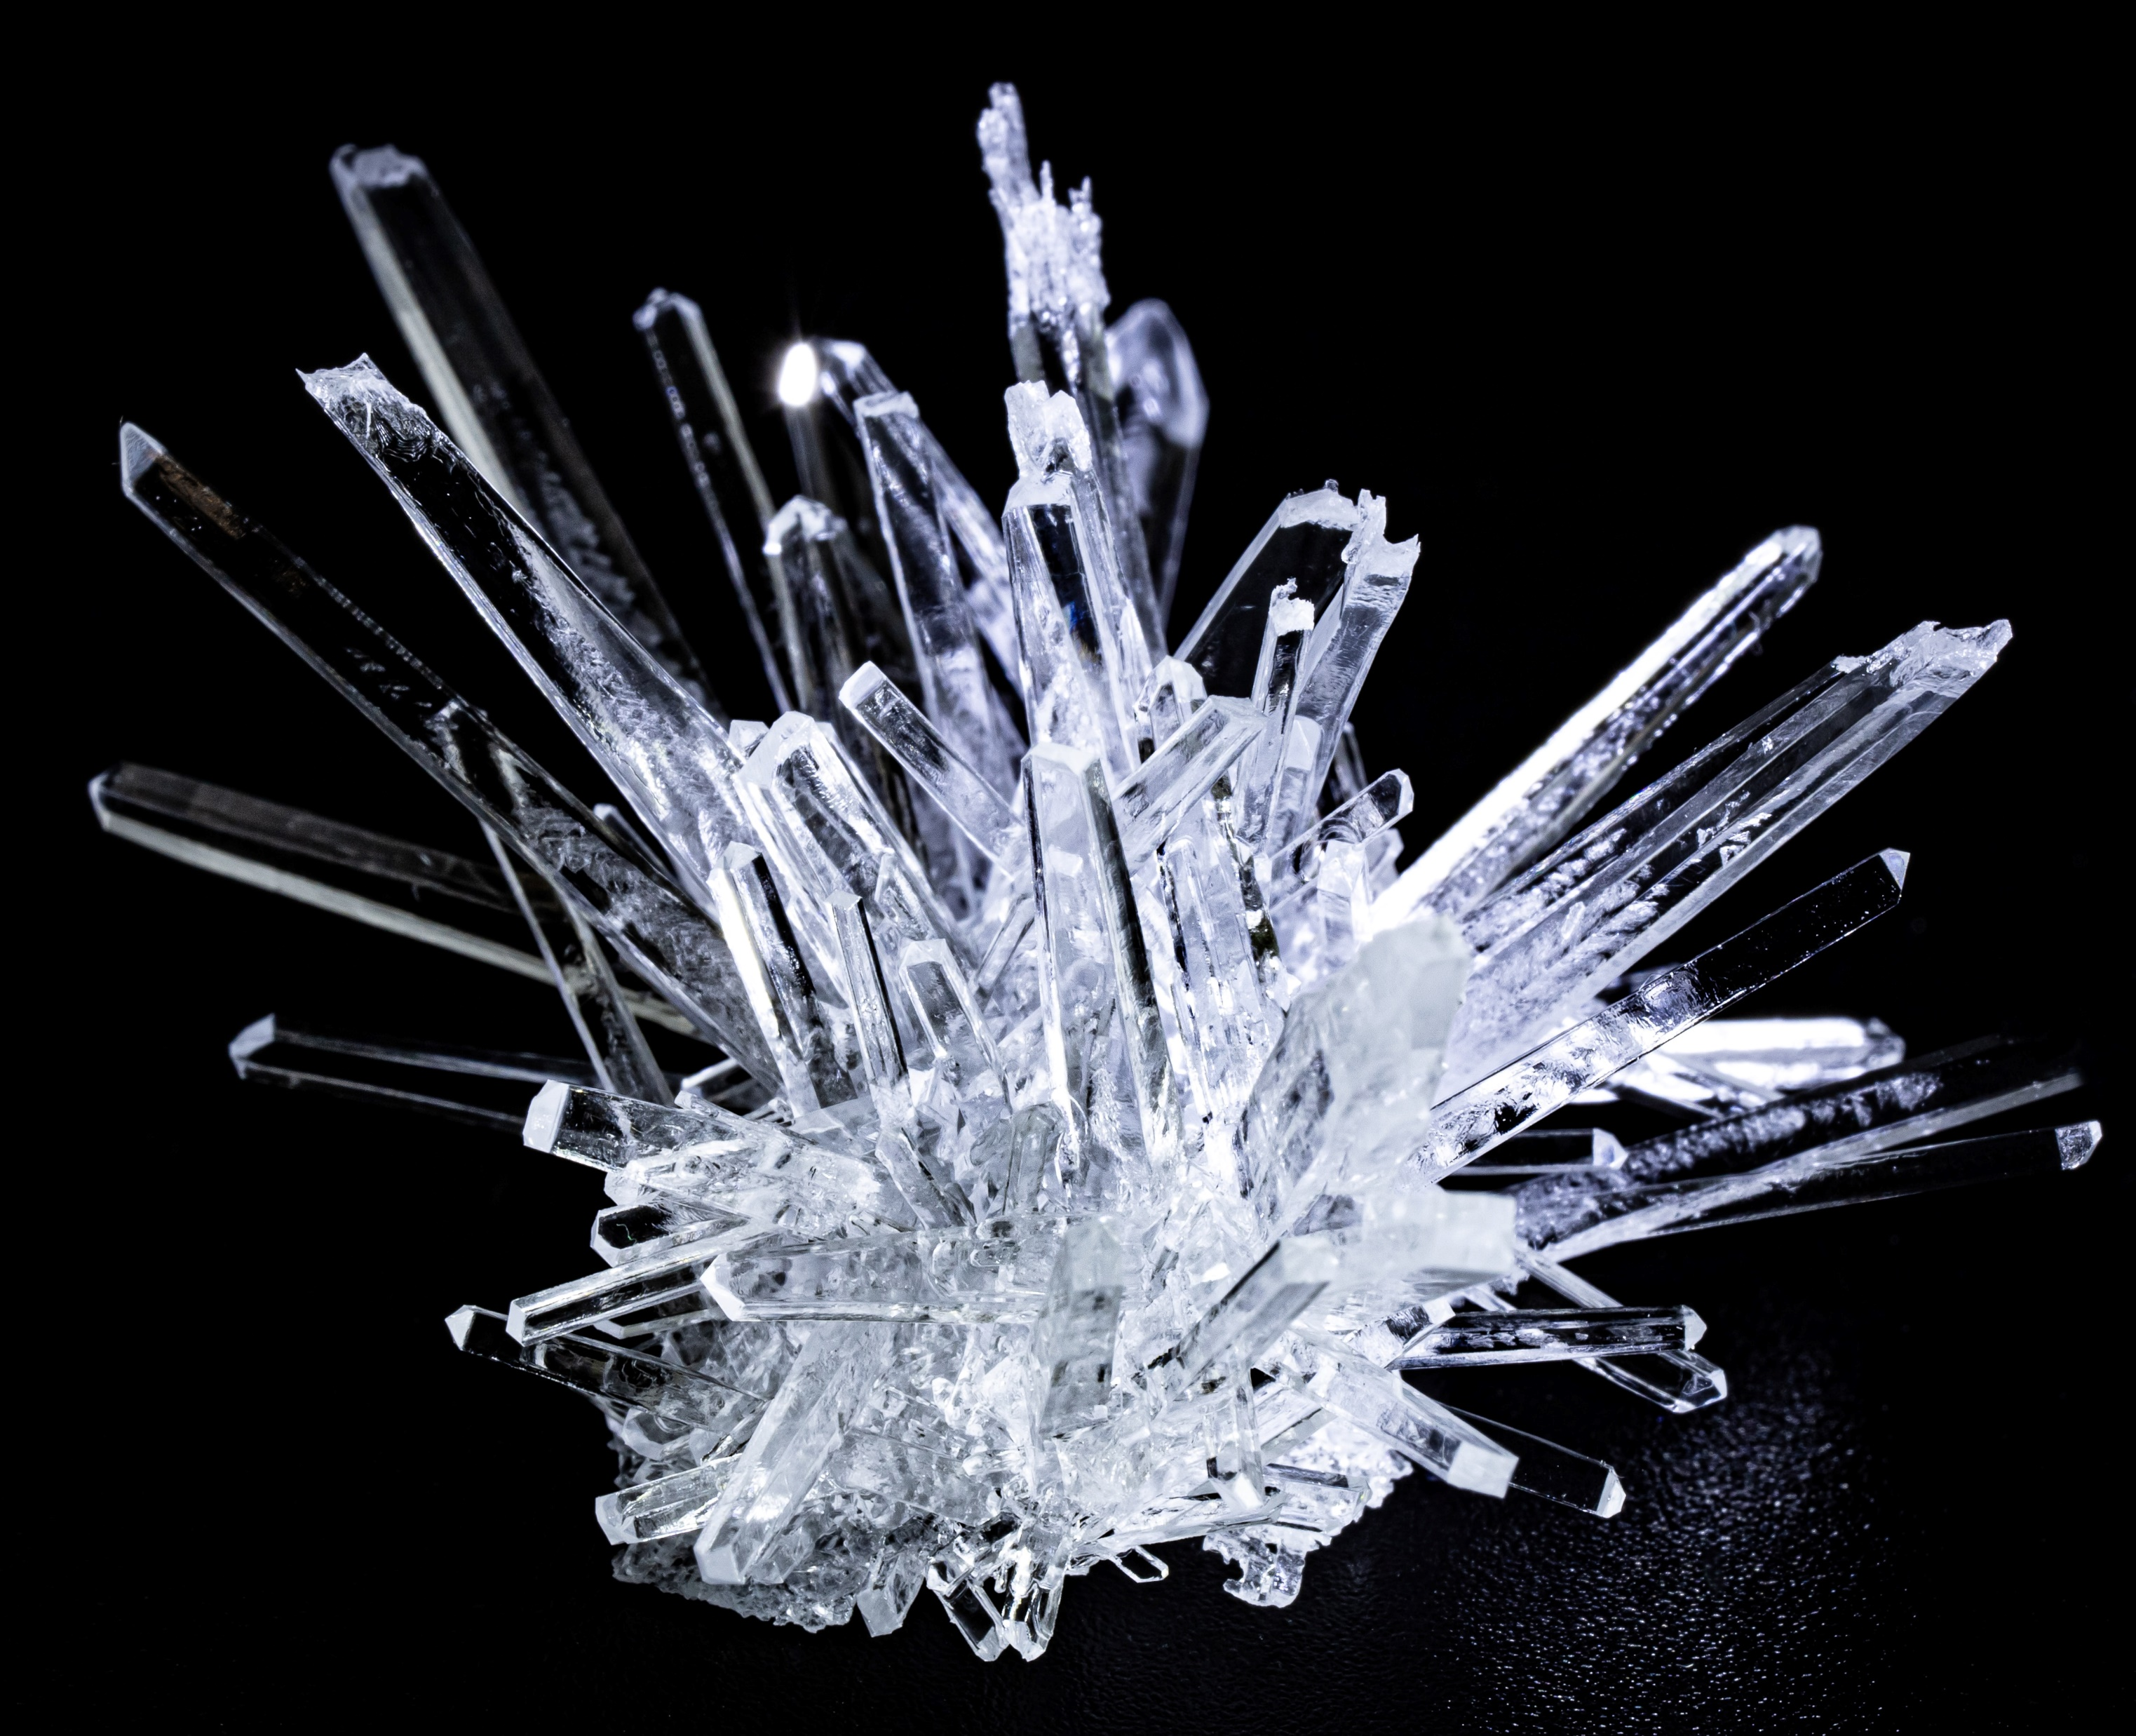
Stage 2 Techniques – Crystallisation
Crystallisation is the process by which a solid forms, within which the atoms form a highly organised structure known as a crystal.
The attributes of the crystal formed depend greatly on the temperature, air pressure, concentration and agitation.
Crystallisation is a crucial step in industry to produce granulated sugar, table salt and fertilisers.
There are two key stages to crystallisation, first the nucleation then crystal growth.

Slide 21
Stage 3:
Recrystallisation

Slide 22

Stage 3 Techniques – Solubility
Solvents will dissolve like solutes
For example, as water is a polar molecule, water is a good solvent for other polar molecules
In this case we are looking to dissolve a hydrocarbon so, using a hydrocarbon as a solvent will be most effective.
Ethanol is considered a useful pretty universal solvent. Its molecular structure allows for it to dissolve polar, hydrophilic and nonpolar and hydrophobic compounds.

Slide 23
Stage 4:
Chromatography

Slide 24
Stage 4 Techniques – Chromatography (TLC)
Chromatography is used to separate mixtures into their individual components
There are two phases involved the stationary phase and the mobile phase
The mixture is then dissolved in the mobile phase.
This phase will flow through the stationary phase, and will carry the components of the mixture with it.
The stationary phase for TLC often contains a UV sensitive fluorescence

Slide 25
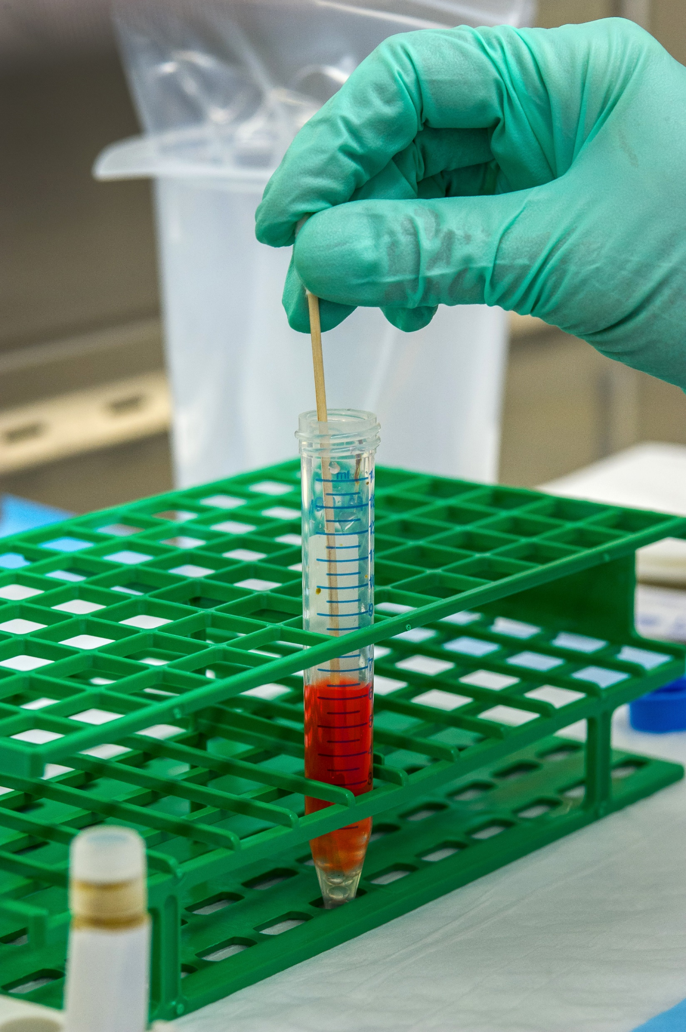
Stage 4 Techniques – Industry Application
Knowing what compounds are within a product, especially in medication is crucial to ensure the medication is safe and effective
Other analysis techniques such as IR and mass spectrometry can all be utilised to quality control medication
In batch production, a sample will often be taken from each batch to ensure quality
It is more difficult to do this with continuous manufacturing, samples are often taken from the line for testing, or inline quality testing methods are used

Slide 26
Stage 5:
Melting Point

Slide 27
Stage 5 Techniques – Melting Point
It is crucial for any medication that we produce to be as pure as possible
Any impurity in the medication could stop it working, or could harm the patient
One way of testing the purity of the aspirin produced is through melting point analysis
By recording the melting point temperature this can be compared to the melting point of pure aspirin
The bigger the difference in melting point, the more impure the aspirin sample is

Slide 28
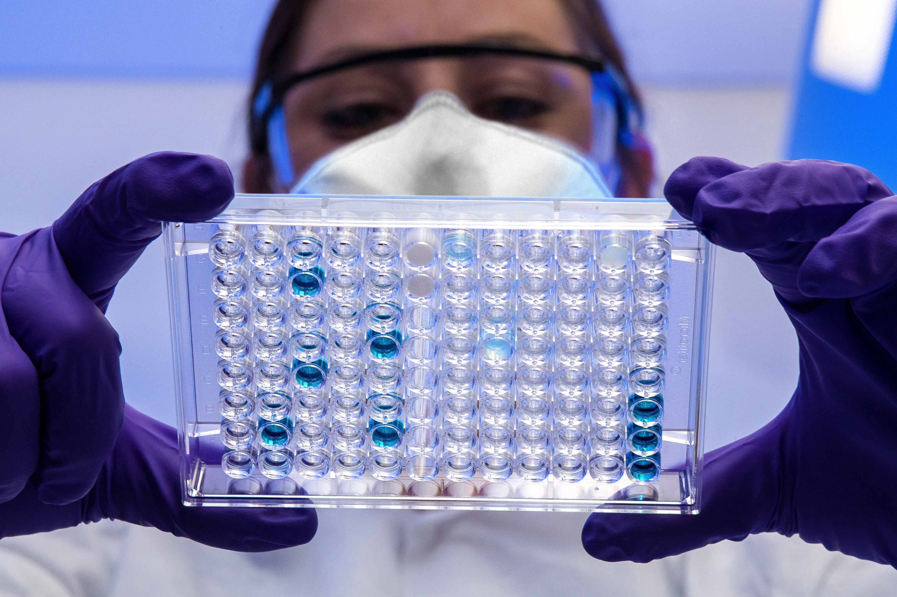
Stage 5 Techniques – Industry Application
In industry the purity of a drug can be measured through UV spectroscopy techniques.
To ensure that the produced medication is up to standard it needs to undergo:
  Sterility Testing
  Bacteriostasis / Fungistasis Testing
  Vaporized Hydrogen Peroxide Ingress Testing

Slide 29
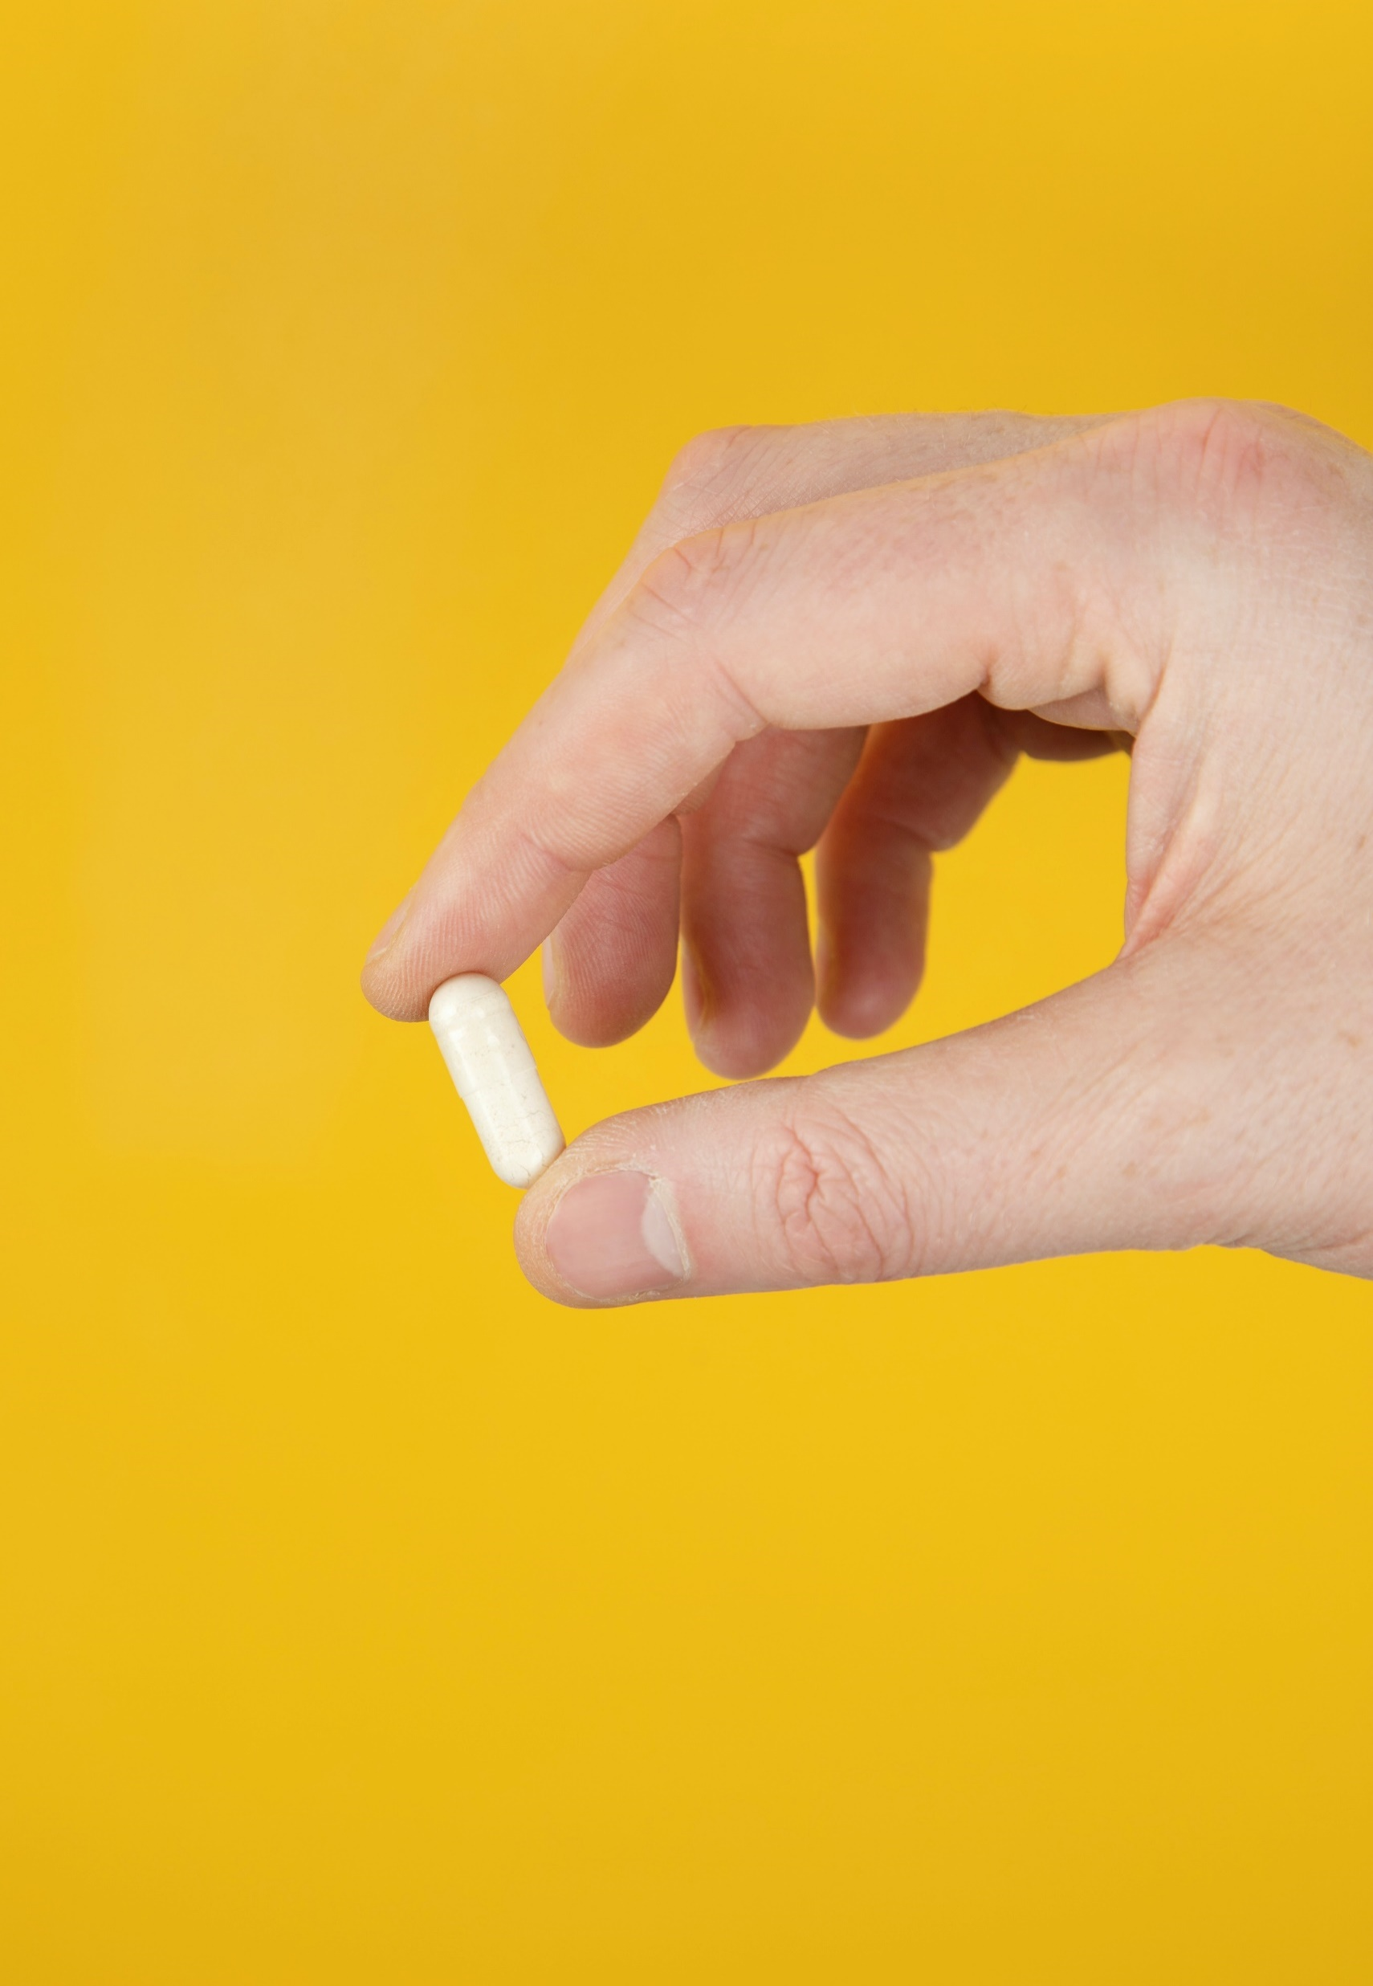
Tablet Making
After these five stages you should be left with powdered aspirin
However, this is not the form we are used to seeing aspirin
We need to take our powder and make a tablet
This requires another stage or processing and more chemicals

Slide 30
Now the step for the chemical engineers!

Slide 31
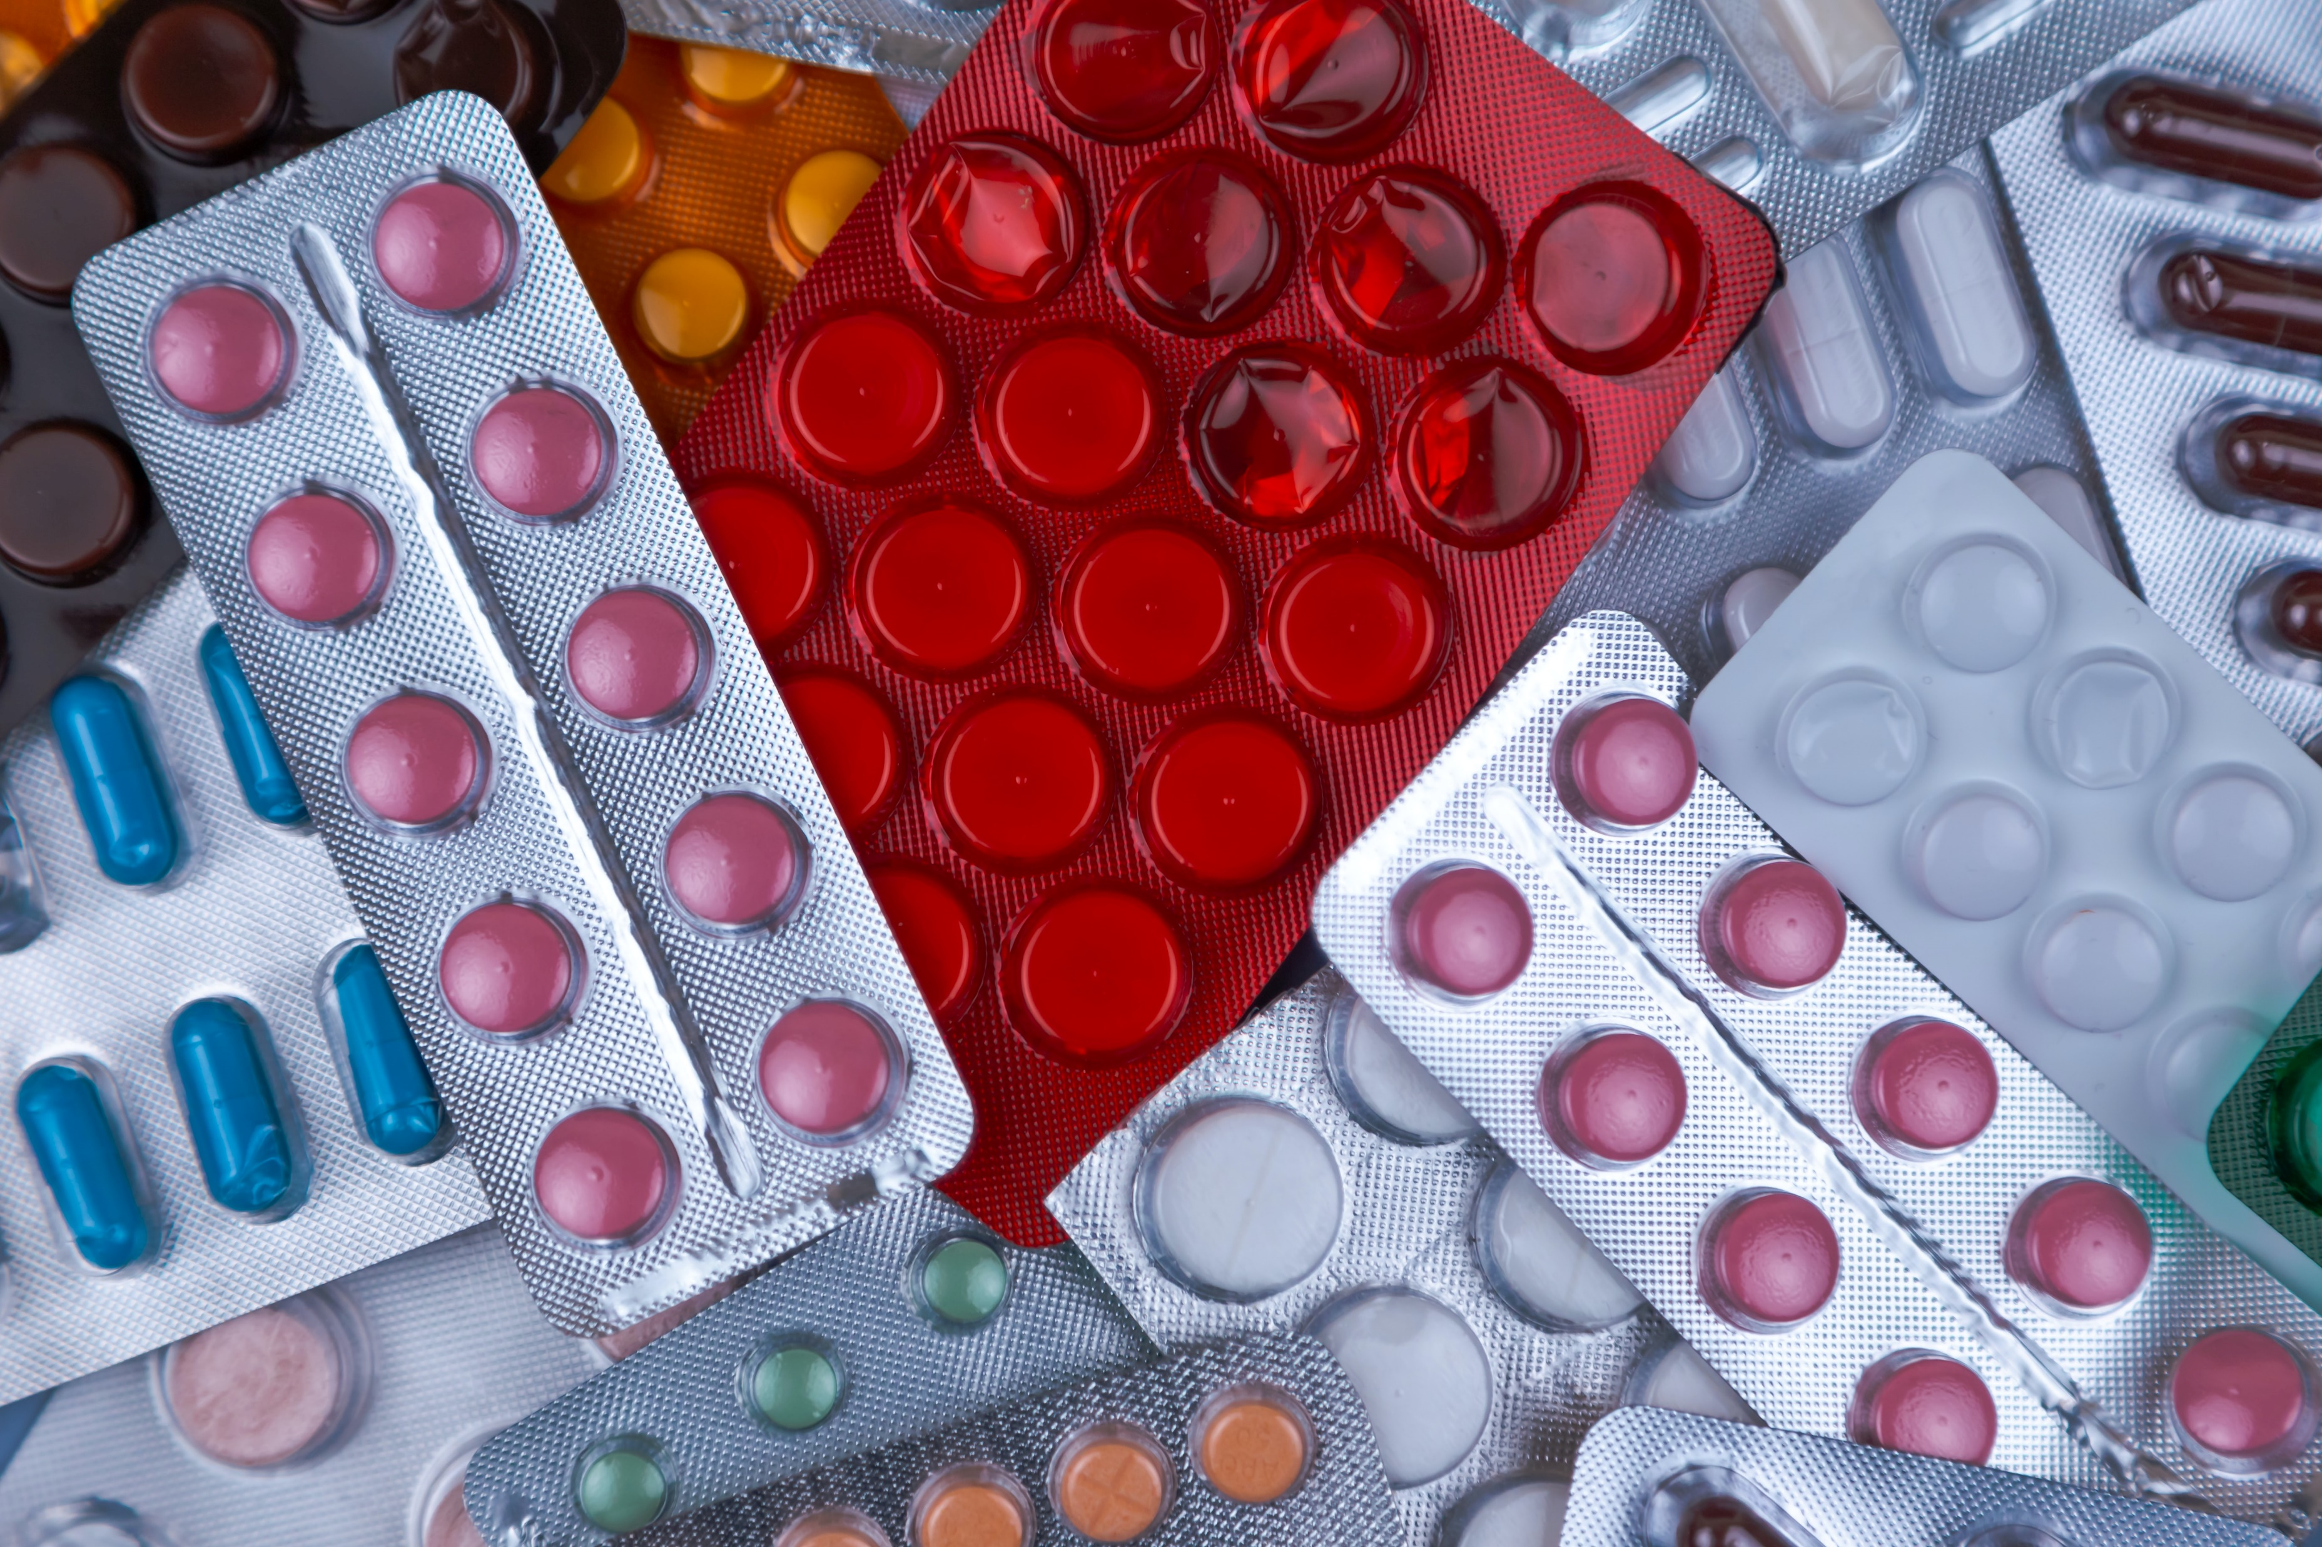
Tablet Making
The active ingredient (e.g. aspirin) often only makes up only a few micrograms of the tablet
But what makes up the rest of
the tablet?

Slide 32
Recipe to make a tablet
Active Ingredient
Bulking Agent
  Increases the volume of the tablet to an acceptable size
Binding Agent
  Allows for the different ingredients in the tablet to bind together
Flowing Agent
  Makes it easier to transport / pour the tablet
Disintegrants
  Help the tablets to break up when in contact with moisture, assisting the absorption process
Lubricant
  Allows the powder to flow into a tablet press

Slide 33
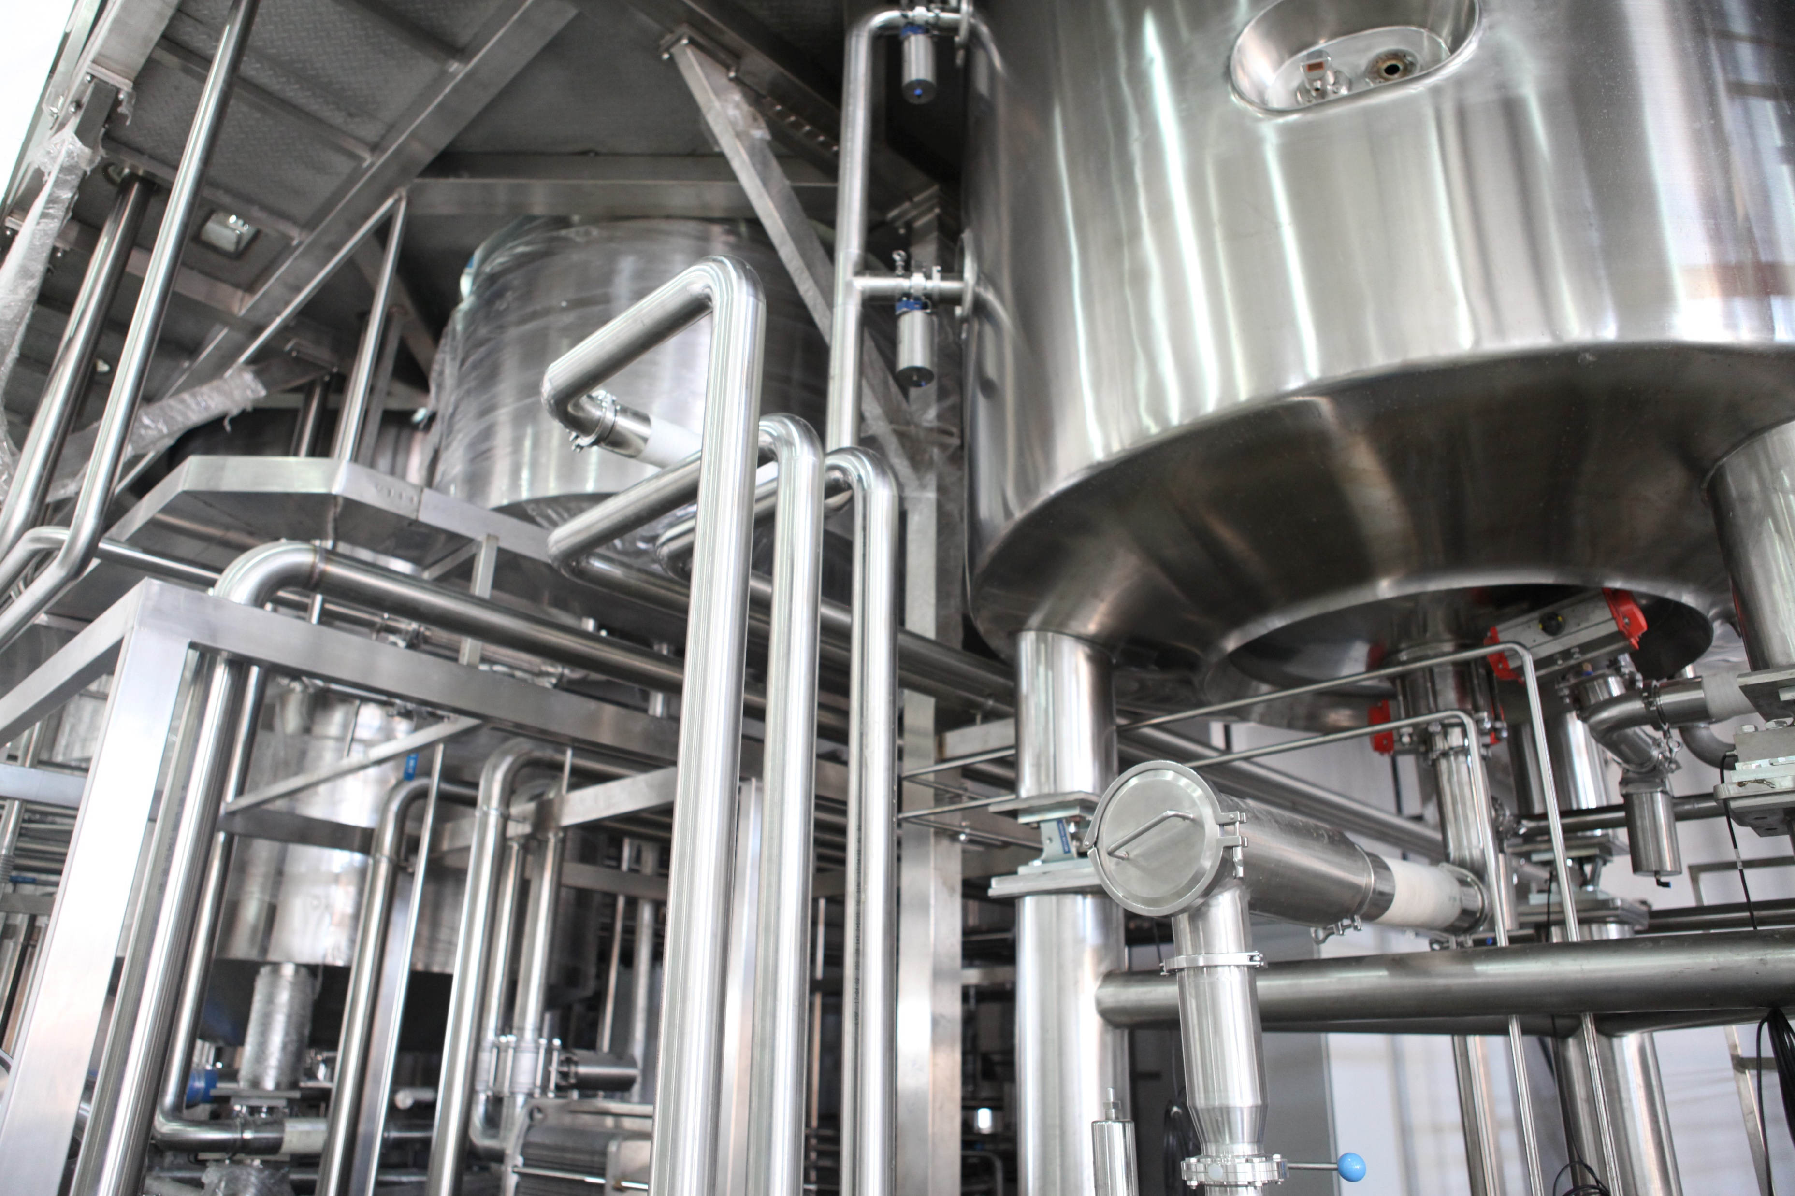
Tablet making process
Granulation machine
Mixing machine
Drying machine
Tablet press
Encapsulating machine
Punches
Packaging machines

Slide 34
Question:
What properties should a tablet have?
Notes:
Ask the group what properties they think a tablet should have

Slide 35
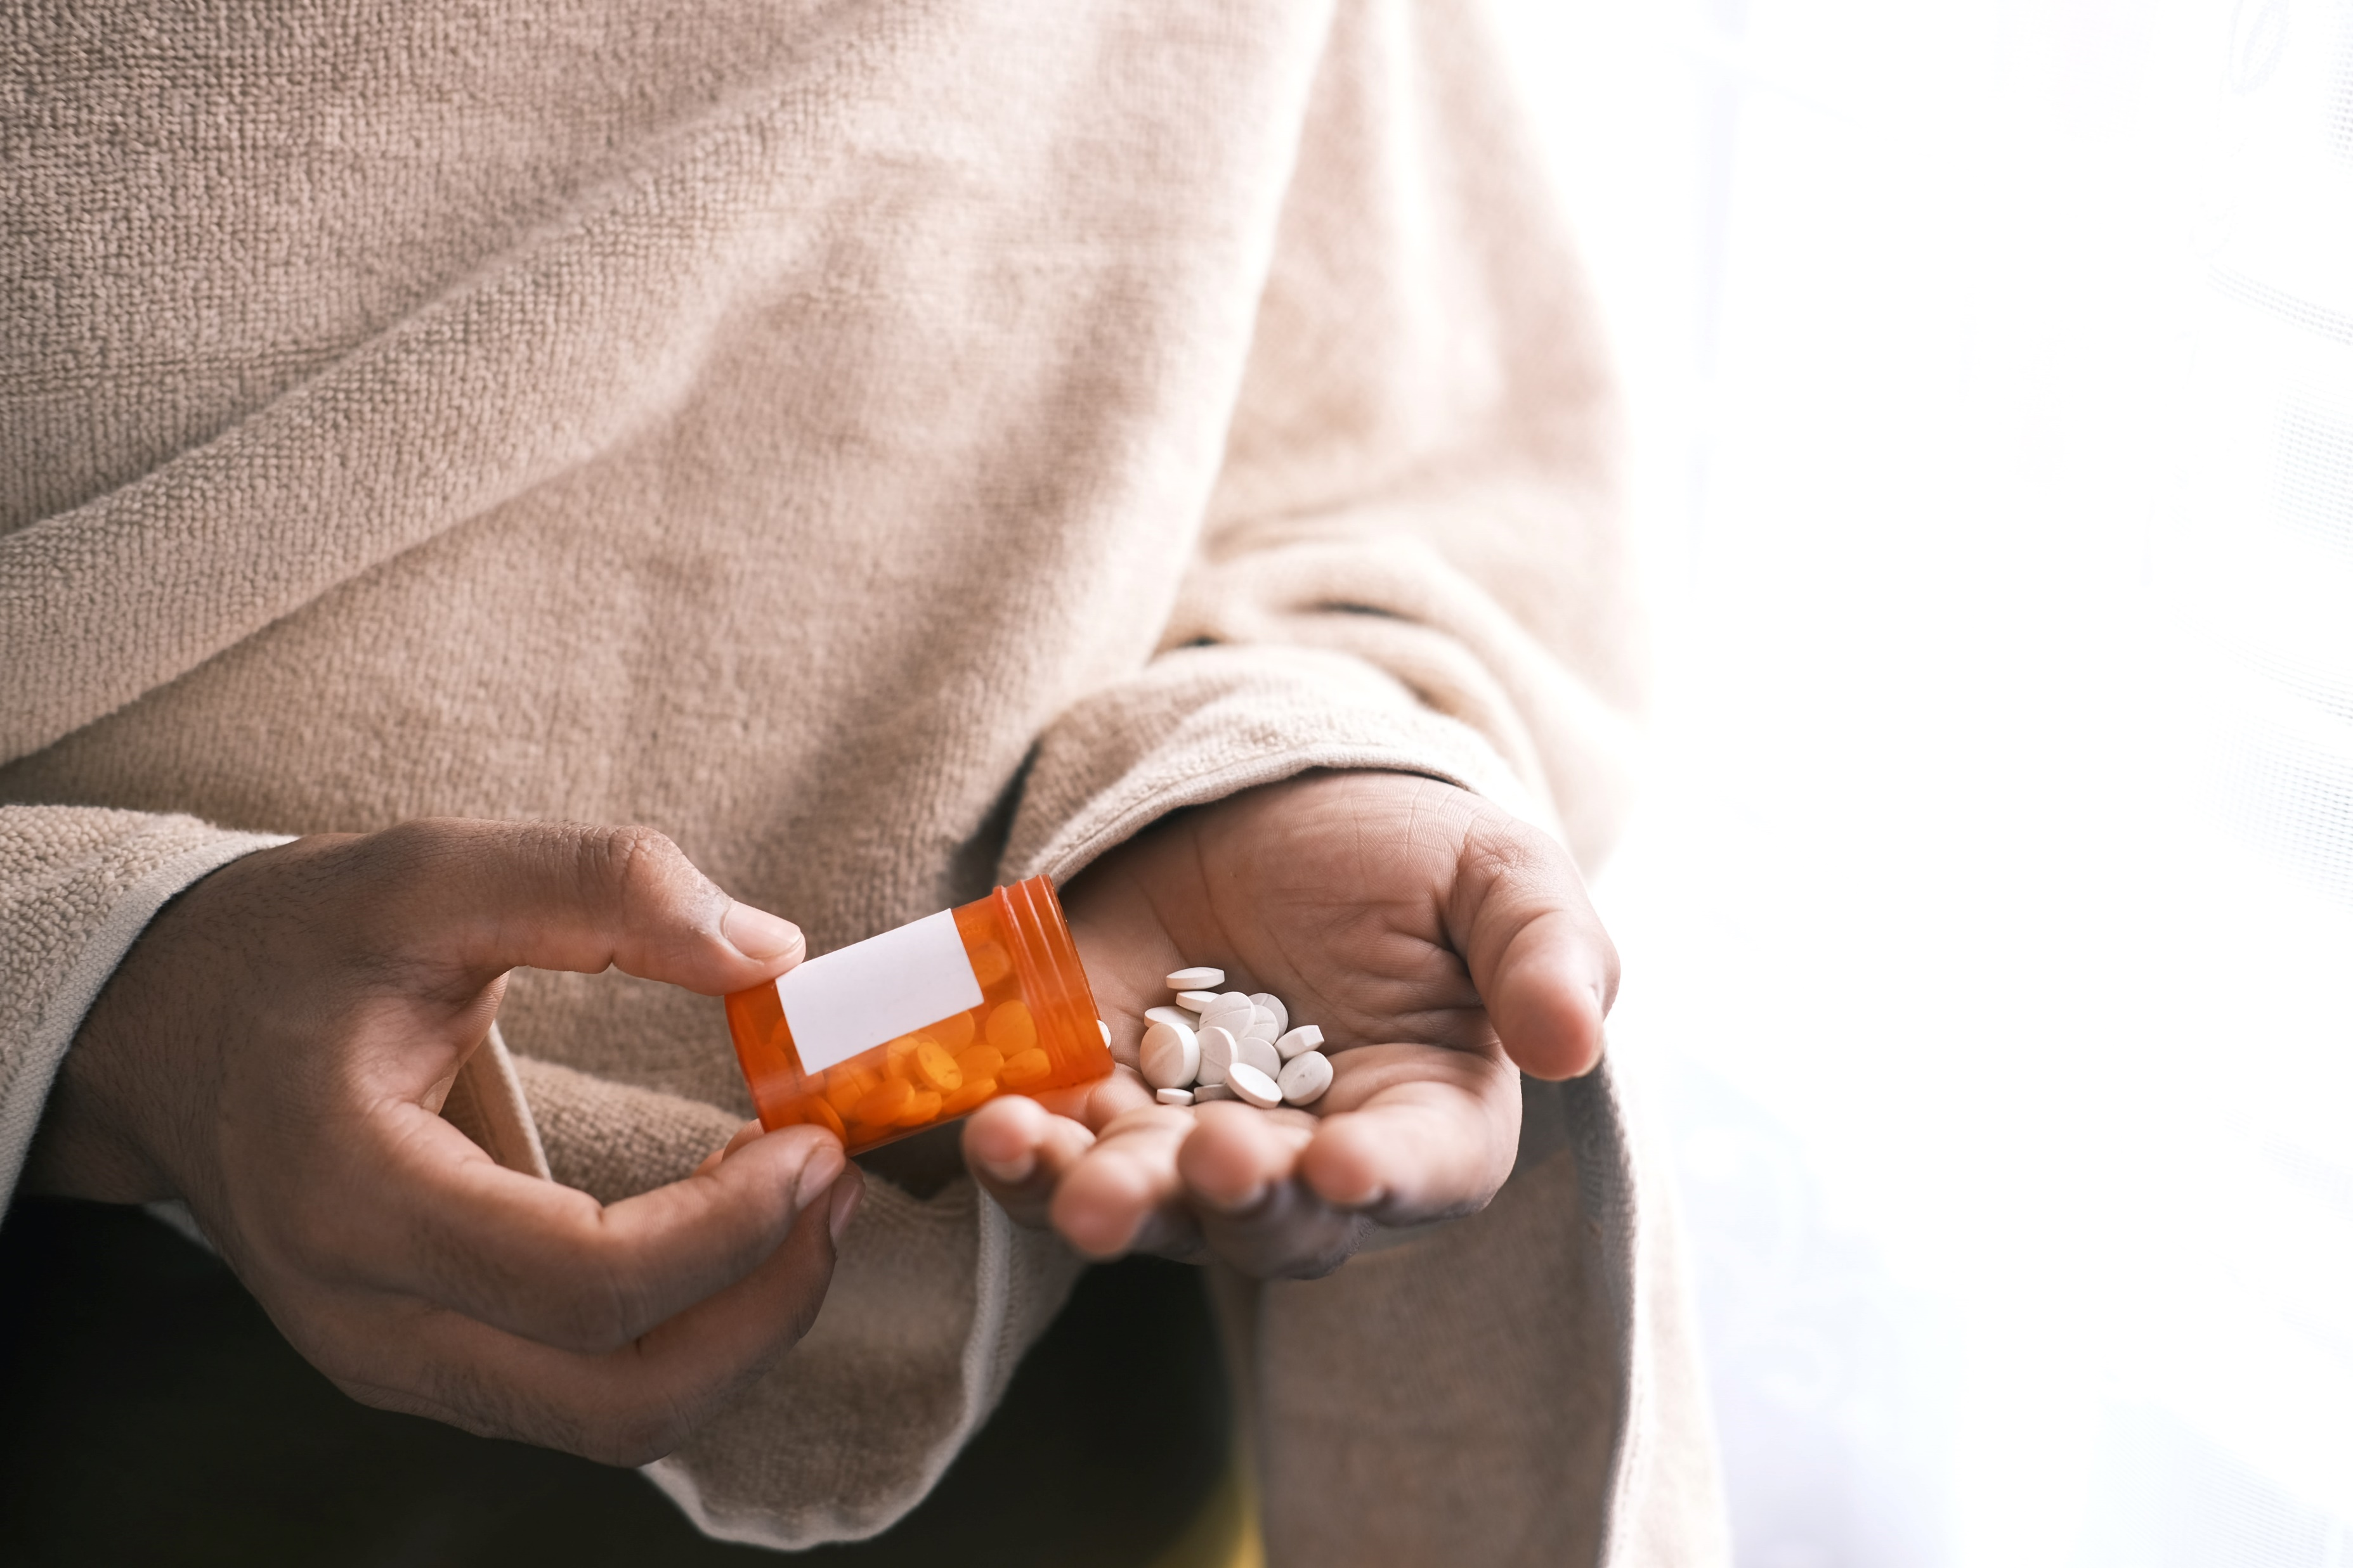
Desirable Properties for a tablet
Easy to swallow
Coated
Small
Pleasant tasting
Therapeutic response
Effective

Slide 36
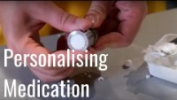
How to make a tablet demonstration

Slide 37
What does the future look like for tablet technology?
Personalised medication
  Patients will metabolise drugs at different rate depending on their metabolism. Therefore, testing a patient’s liver enzymes will allow for an optimum dosage of the drug to be prescribed.
  Tablets can be printed, using a 3D printer, to contain multiple different drugs at a dosage that is specific to the patient. This will be particularly useful for older patients or those with complex health conditions that require many different tablets in a day. Having to take fewer tablets will increase patient compliance with treatment.

Slide 38
Question:
What are the potential downsides to personalised medicine?

Slide 39
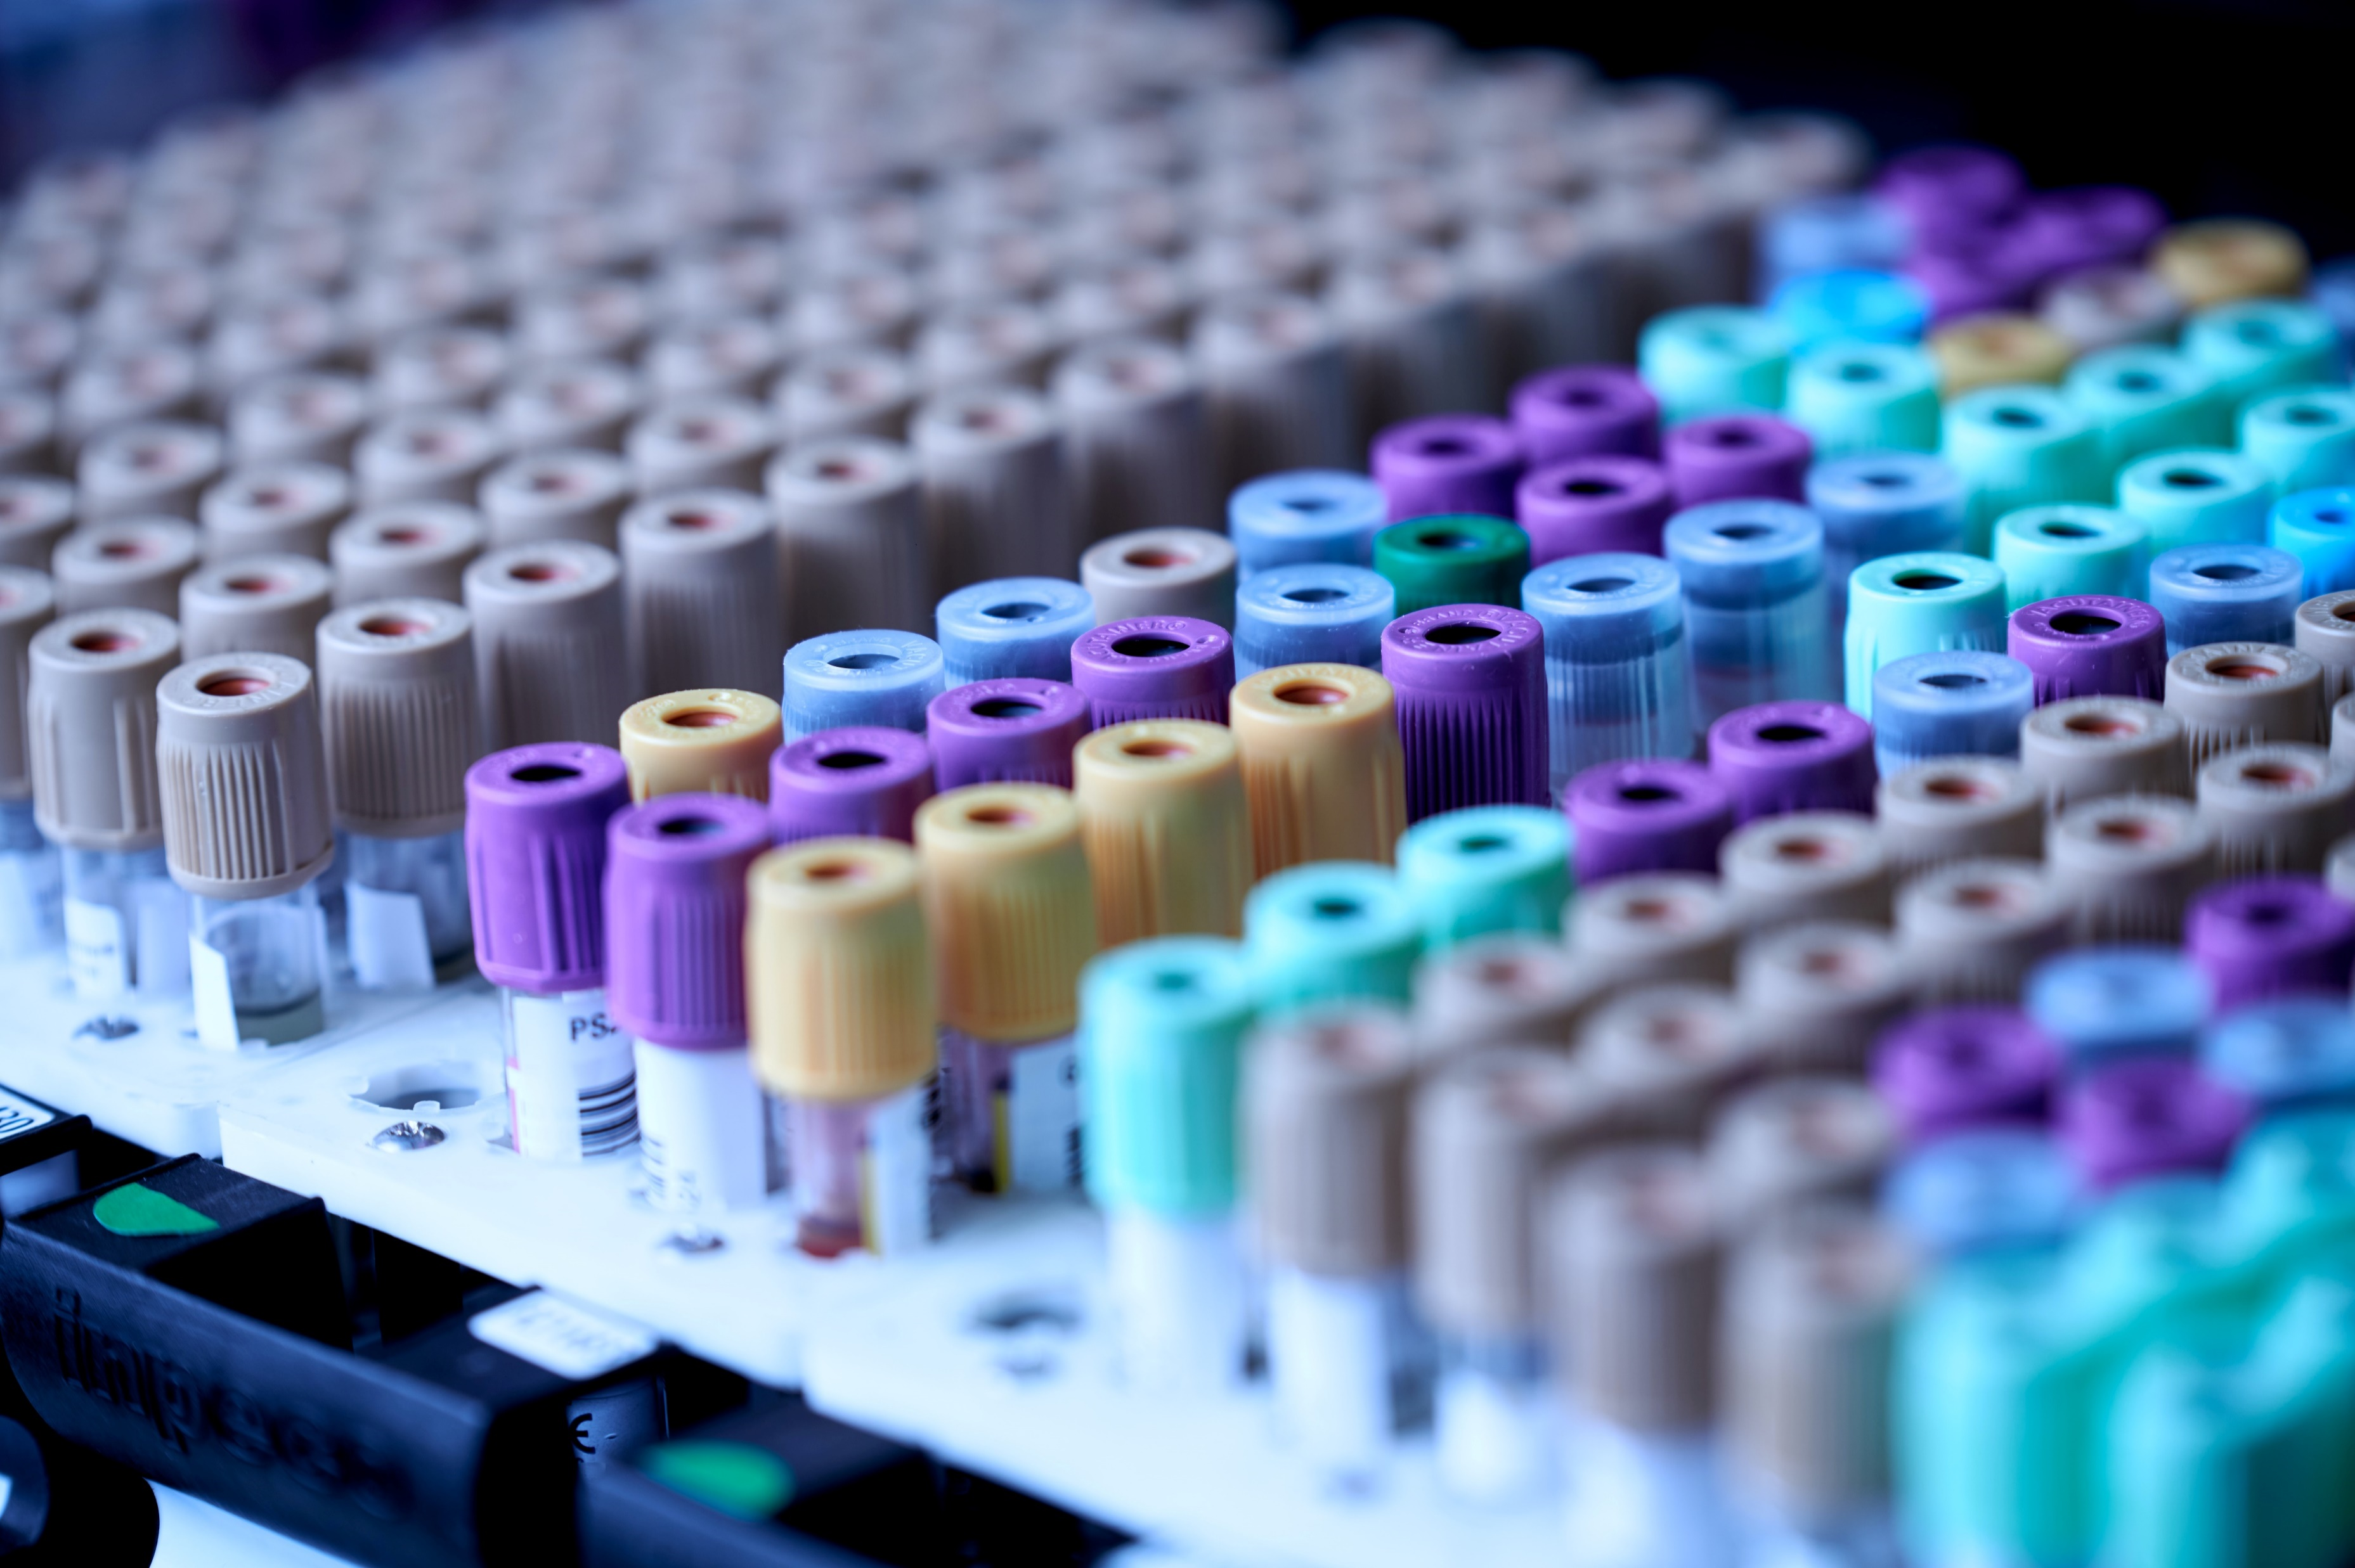
How are Chemical Engineers shaping the future of our health?
Reducing tissue scarring
Cornea gels to fight peripheral ulcerative keratitis
Blood tests to detect prostate cancer
Trauma recovery
3D printing hip replacements

Slide 40
Development in Drug Trials
Researchers at the University of Birmingham are looking at how to remove the need for animal testing during the drug development process
The aim is to create ‘chips’ that can replicate parts of the body. This would allow the body’s response to the drug to be measured.
At the moment cartilage, eyes, tissues and bones can be simulated.
The aim is to link chips together to mimic the effect on the whole body

Slide 41
Metal 3D Printing
Research is being completed to explore the possibility of 3D printing hip replacements.
The key advantage of 3D printing is the ability to add antibiotics into the hip structure
This limits the chance of infection and therefore the need for further surgery
The replacement can also be laced with drugs to promote good both growth

Slide 42
Any Questions?
What have you learnt?

Slide 43



