Slide 1

Delivering Medicine to Neonates
How do chemical engineers develop medical technology to solve problems in low-resource countries?

Slide 2

Not everyone likes the taste of medicine - especially children!

Slide 3
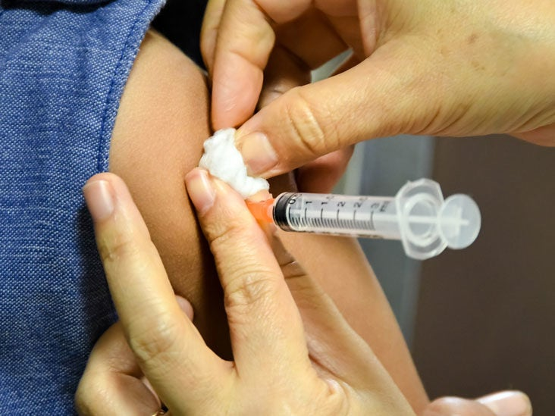
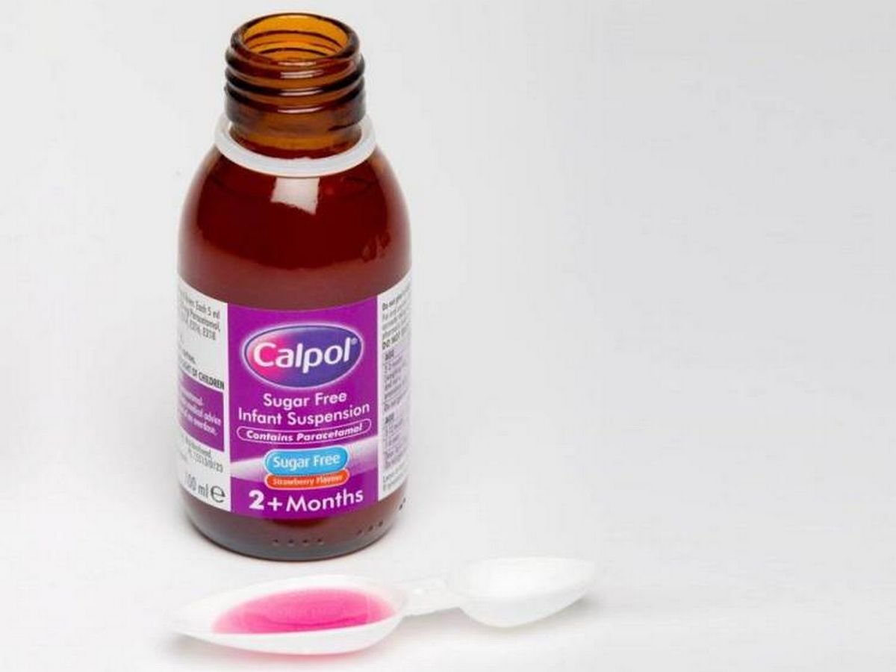
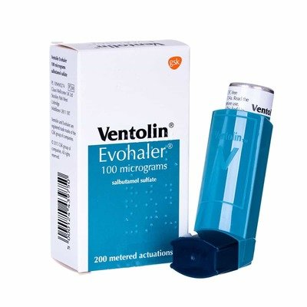
There are different types of medicine available:
Liquid formulations
Pills
Inhalers
Injections
The most commonly administered medicine for infants is a liquid formulation (Kendall et al, 2017). Think Calpol!

Slide 4
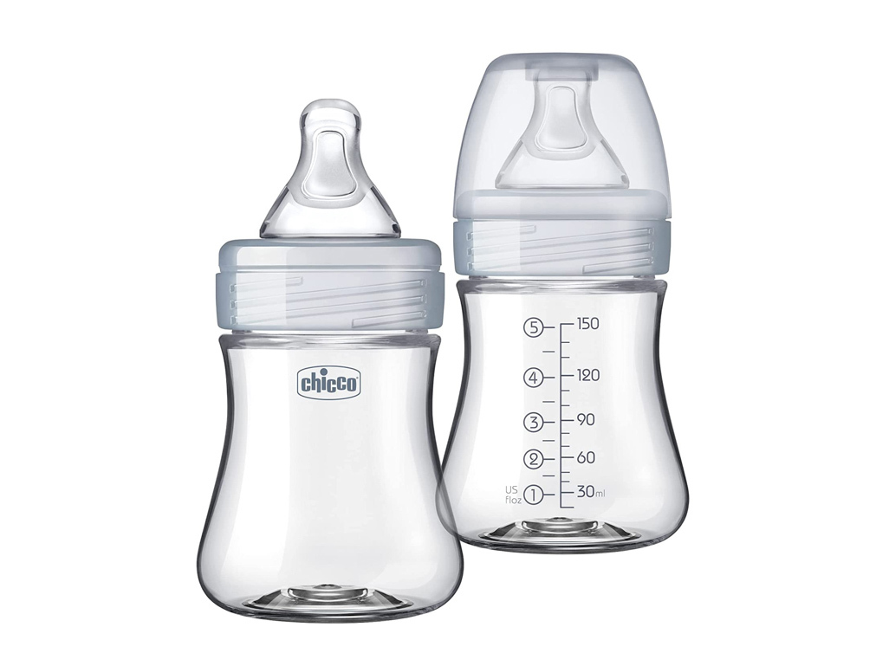
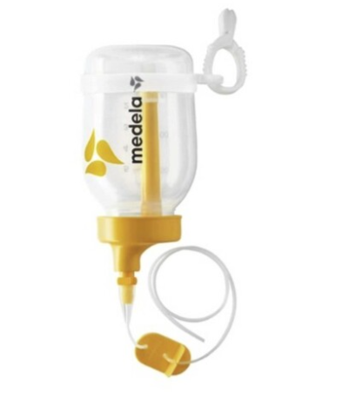
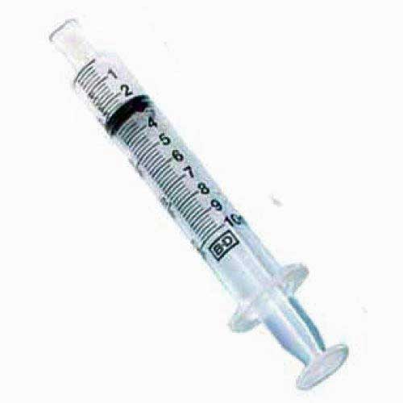
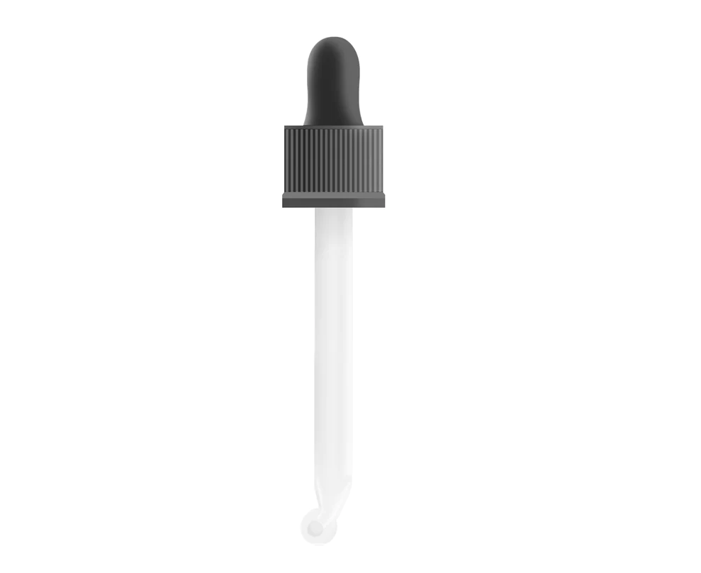
Discuss and match up!
On your tables you will find typical equipment that is used to administer medicine or milk.
Talk to each other about what you think the advantages and disadvantages might be of each device and complete the worksheet.

Slide 5
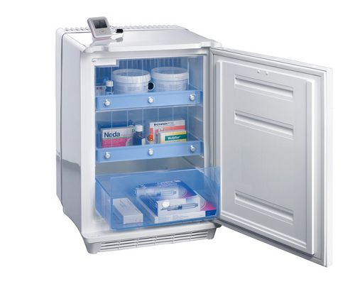
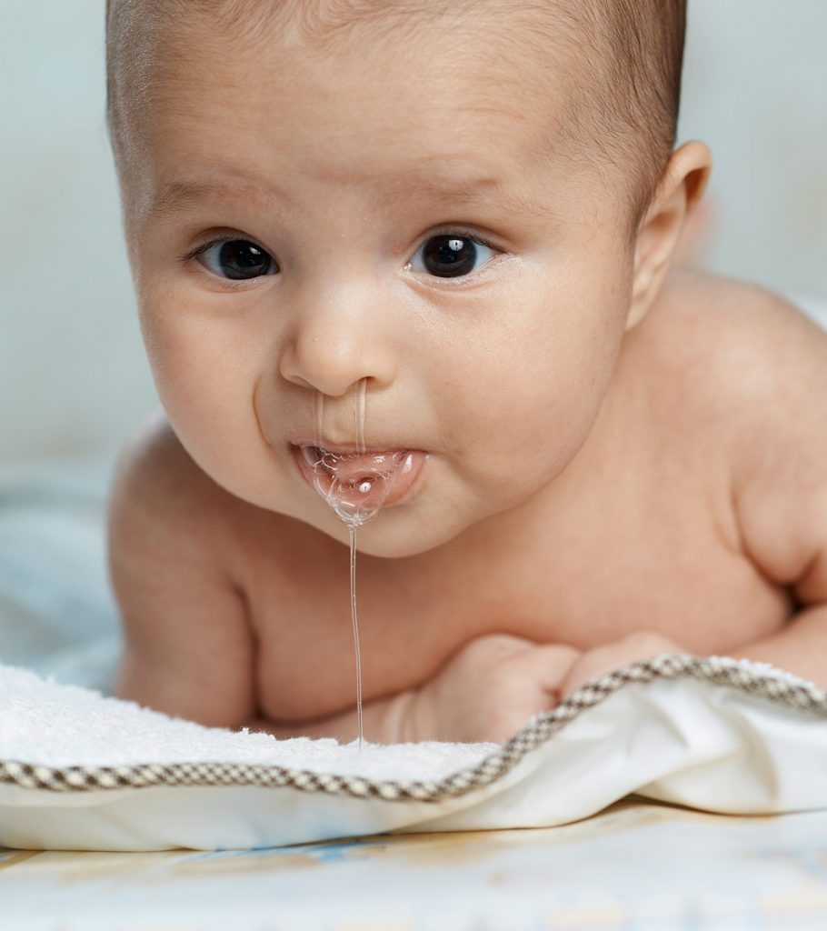
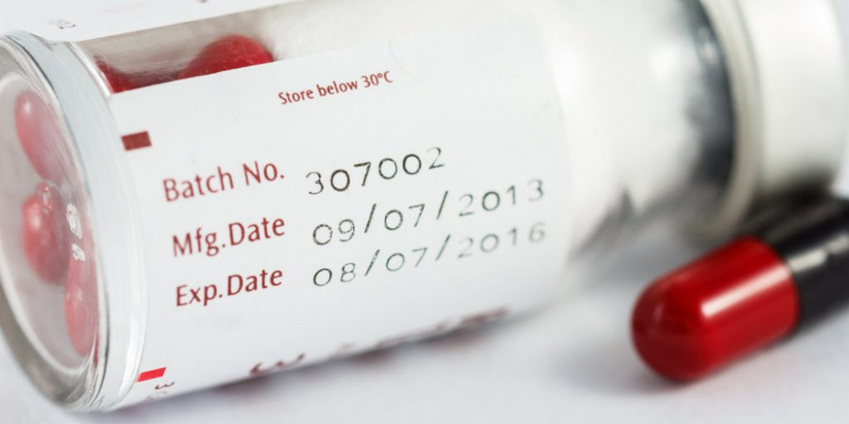
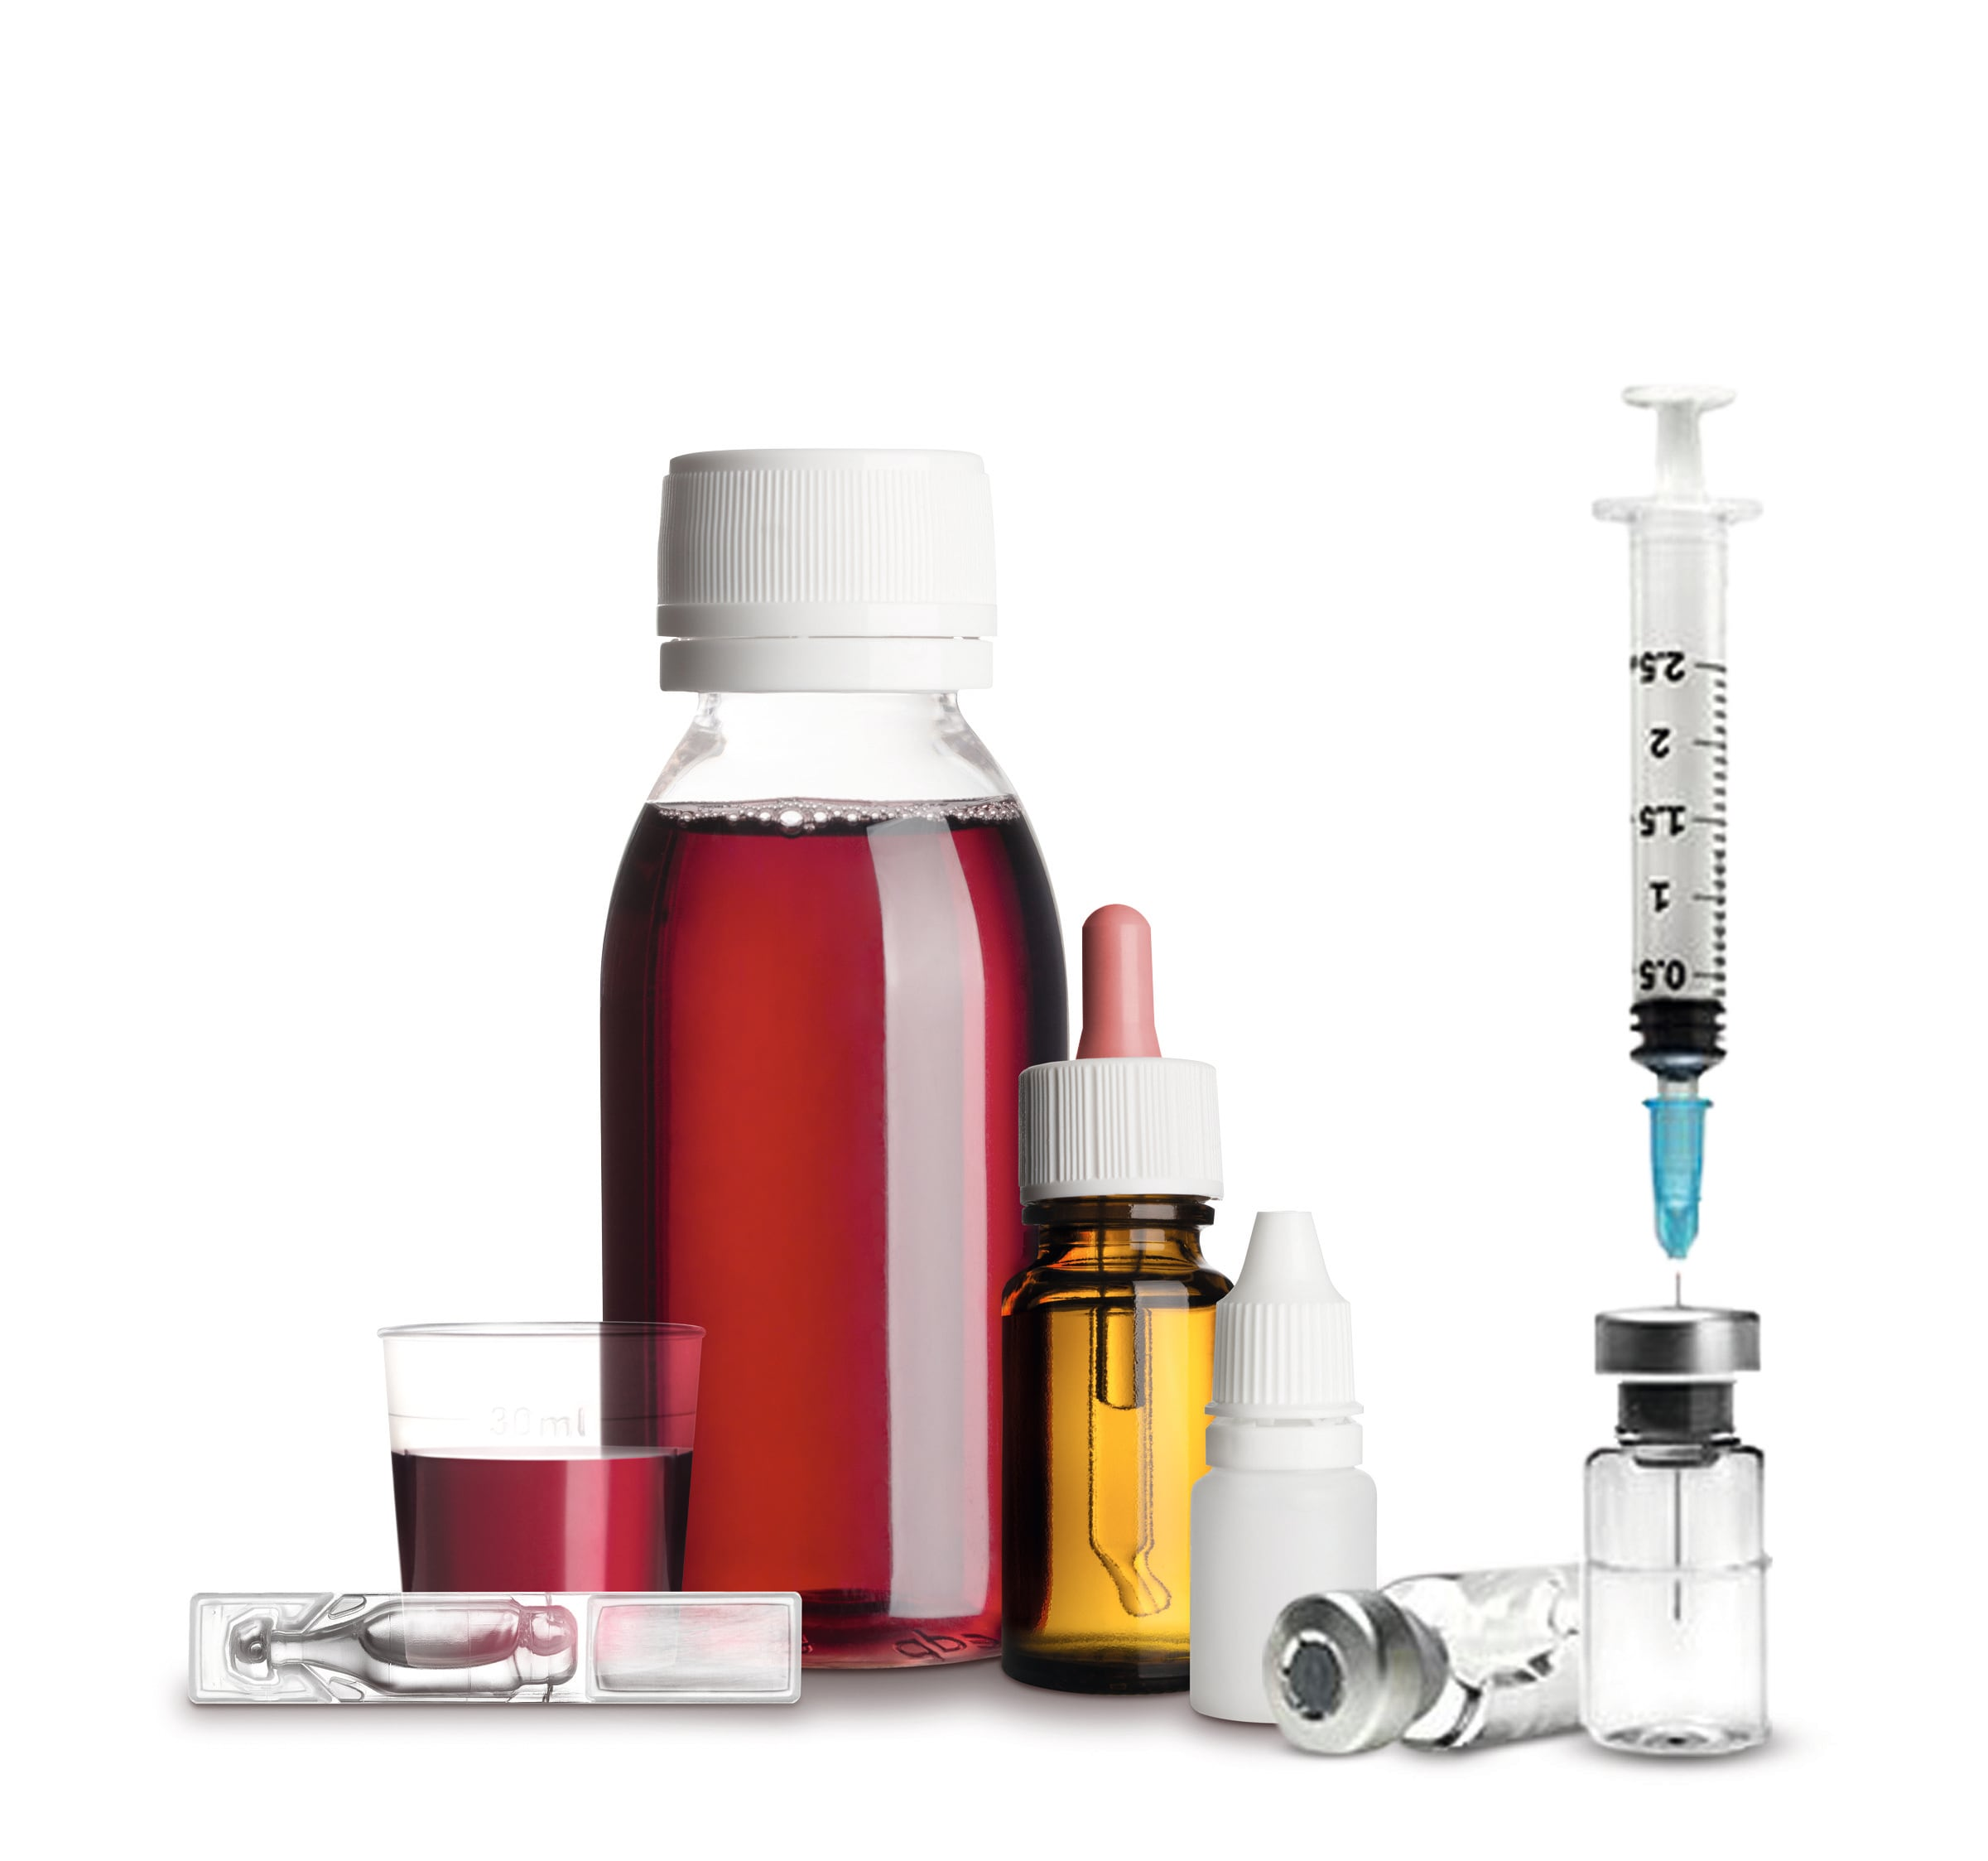
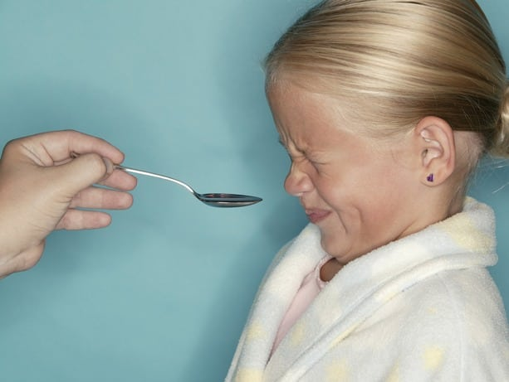
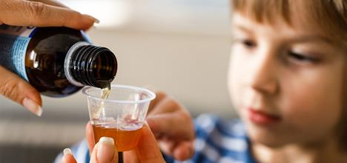
What challenges are associated with feeding liquid formulation to a neonate in a low resource country?
Use the pictures to help you.

Slide 6
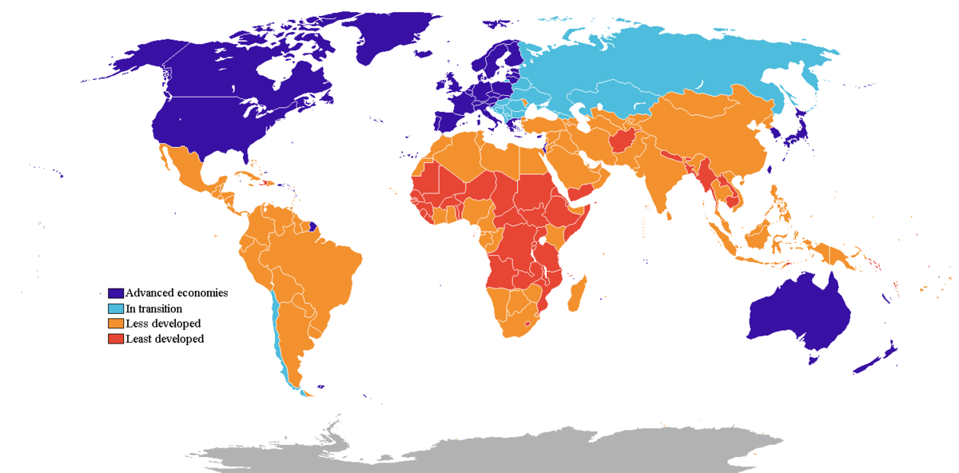



In low-resource countries, liquid medicines are:
Expensive (Orubu and Tuleu, 2017)
Limited shelf life (Kendall et al, 2017)
Needs to be refrigerated and stored in a hygienic place to avoid contamination (JustMilk, n.d.)
The medicine may contain unpleasant flavours or additives and deter the child from consuming it. (Mennella et al, 2013)
Without proper equipment, it is difficult to accurately measure the correct dosage of medicine (Cheung, Bouvy and De Smet, 2009)
Notes:
Add references

Slide 7



WHO: Sustainable Development Goals
SDG Target 3.2
Newborn and child mortality: By 2030, end preventable deaths of newborns and children under 5 years of age, with all countries aiming to reduce neonatal mortality and under‑5 mortality (www.who.int, n.d.)

Slide 8

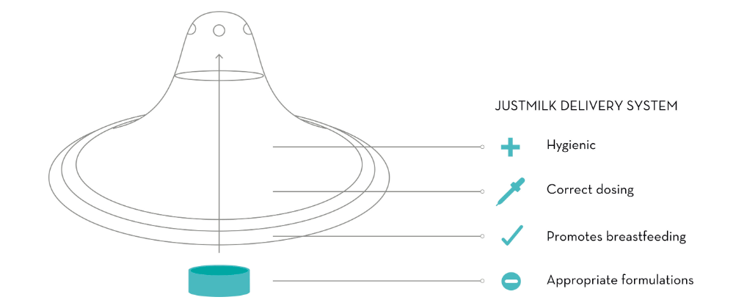

So how do we meet this?
In 2013, a company called JustMilk engineered a solution.
They adapted the process of breastfeeding and created a silicone shield that the mother could place over her breast, and at the tip of the shield, is a rapidly disintegrating pill. When the baby feeds from the mother, the pill disintegrates into the milk, and so the baby takes in the medicine without knowing.
The organisation conducted studies in Kenya and found that community members had a positive response towards using the device. Can you think of why?
This is where the pill is inserted. Why is a pill better than a liquid formulation?

Slide 9

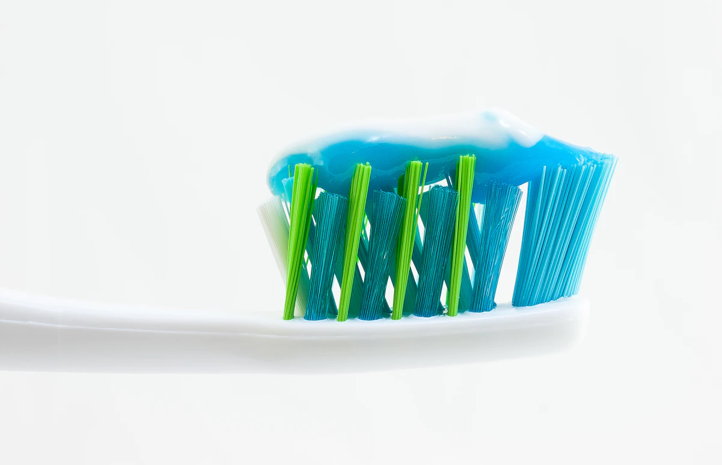

Let's think about taste . . .
What makes a good medicine? What makes it taste 'good enough' for a child to consume it without throwing a tantrum?
Imagine if they made medicine the flavour of a honeycomb latte. What would be the problem with that?
Likewise, why don't they make toothpaste chocolate flavoured? It would taste good, it would motivate people to brush their teeth more, but then they'd never spit it out!

Slide 10
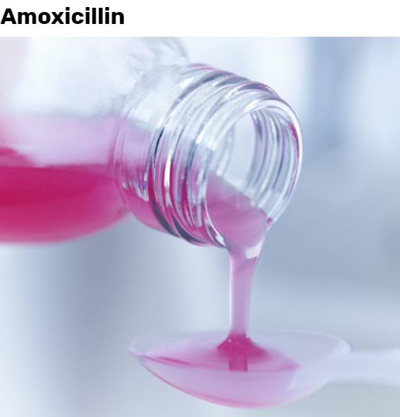
Your turn!
Split yourselves into 2-4 groups. You have two tasks:
Your first job is to design the perfect medicine. What ingredients would you add to make it taste good? Would it be in the form of a pill or a liquid formulation? Be prepared to justify your choices. What production methods would you use to make it? Use the manufacturing sheet and the chemical flavours sheet to help you!
You will also design a piece of equipment that can be used to deliver the medicine to a child.
Did you know?
Amoxicillin uses synthetic fruit flavourings to make the medicine appealing to young children (Chueca, Pagan and Garcia-Gonzalo, 2014). Banana flavour is made using 3-Methylbutyl ethanoate, which is an ester. To make an orange flavour, limonene is used, which in IUPAC terms is 1-methyl-4-(1-methylethenyl)-cyclohexene (Chemoxy Ltd, 2016).
Notes:
They’re often synthetic fruit flavourings. Banana is very common (and is used to flavour the blue slushes, and bubblegum). That’s isoamyl acetate. Limonene is a strong orange flavour. Acerola is used for cherry (and is a favourite of mine). Manzanate gives an apple flavour. Methyl anthranilate gives the grape flavour in many American soft drinks. Strawberry flavours come from ethyl methylphenylglycidate.

Slide 11
Judging criteria:
For each category, give the group a score out of 5. 5 being the best, 0 being the worst.
Does it (hypothetically) taste good?
How are the risks of each chemical minimised to ensure that it is safe for children to consume?
Is the manufacturing method well-justified? Has the group mentioned how they will overcome the disadvantages?
Has the group mentioned what they will use to administer the medicine? Will it be a spoon, a syringe, a dropper? How will they ensure that the person using the medicine will measure the correct amount?

Slide 12
References:
Chemoxy Ltd (2016). The Science Behind Food Flavourings. [online] Chemoxy International. Available at: https://www.chemoxy.com/about-2/knowledge-hub/the-science-behind-food-flavourings/.
Cheung, K.C., Bouvy, M.L. and De Smet, P.A., 2009. Medication errors: the importance of safe dispensing. British journal of clinical pharmacology, 67(6), pp.676-680.
Chueca, B., Pagan, R. and Garcia-Gonzalo, D., 2014. Differential mechanism of Escherichia coli inactivation by (+)-limonene as a function of cell physiological state and drug's concentration. PloS one, 9(4), p.e94072.
JustMilk. (n.d.). What We Do. [online] Available at: http://www.justmilk.org/what-we-do [Accessed 24 Jul. 2023].
Kendall, R., Lenoir, J., Gerrard, S., Scheuerle, R.L., Slater, N.K. and Tuleu, C., 2017. Using the Slug Mucosal Irritation assay to investigate the tolerability of tablet excipients on human skin in the context of the use of a nipple shield delivery system. Pharmaceutical research, 34, pp.687-695.
Mennella, J.A., Spector, A.C., Reed, D.R. and Coldwell, S.E., 2013. The bad taste of medicines: overview of basic research on bitter taste. Clinical therapeutics, 35(8), pp.1225-1246.
Orubu, E.S. and Tuleu, C., 2017. Medicines for children: flexible solid oral formulations. Bulletin of the World Health Organization, 95(3), p.238.
www.who.int. (n.d.). SDG Target 3.2 | Newborn and child mortality: By 2030, end preventable deaths of newborns and children under 5 years of age, with all countries aiming to reduce neonatal mortality and under‑5 mortality. [online] Available at: https://www.who.int/data/gho/data/themes/topics/indicator-groups/indicator-group-details/GHO/sdg-target-3.2-newborn-and-child-mortality#:~:text=By%202030%2C%20end%20preventable%20deaths%20of [Accessed 27 Jul. 2023].

