Slide 1

GCSE Chemistry
Life Cycle Assessment & Use of Earth’s Resources
James White
School of Chemical Engineering
University of Birmingham
Slides with an underlined title contain key knowledge for your exams

Slide 2
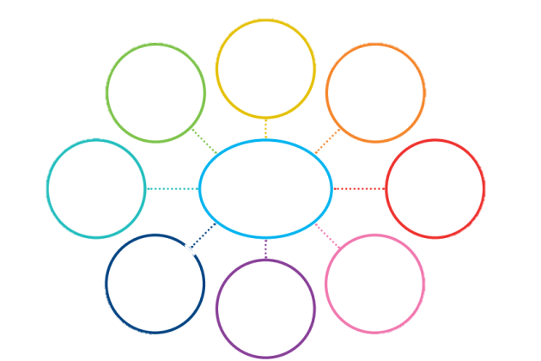

What is Sustainability?
5 minute activity – create a sustainability mind map
Split your A3 paper in half
Draw a mind map in one half of the paper with sustainability in the centre
Add any words, objects or themes that you associate with the word sustainability
There are no wrong answers!
Sustainability

Slide 3
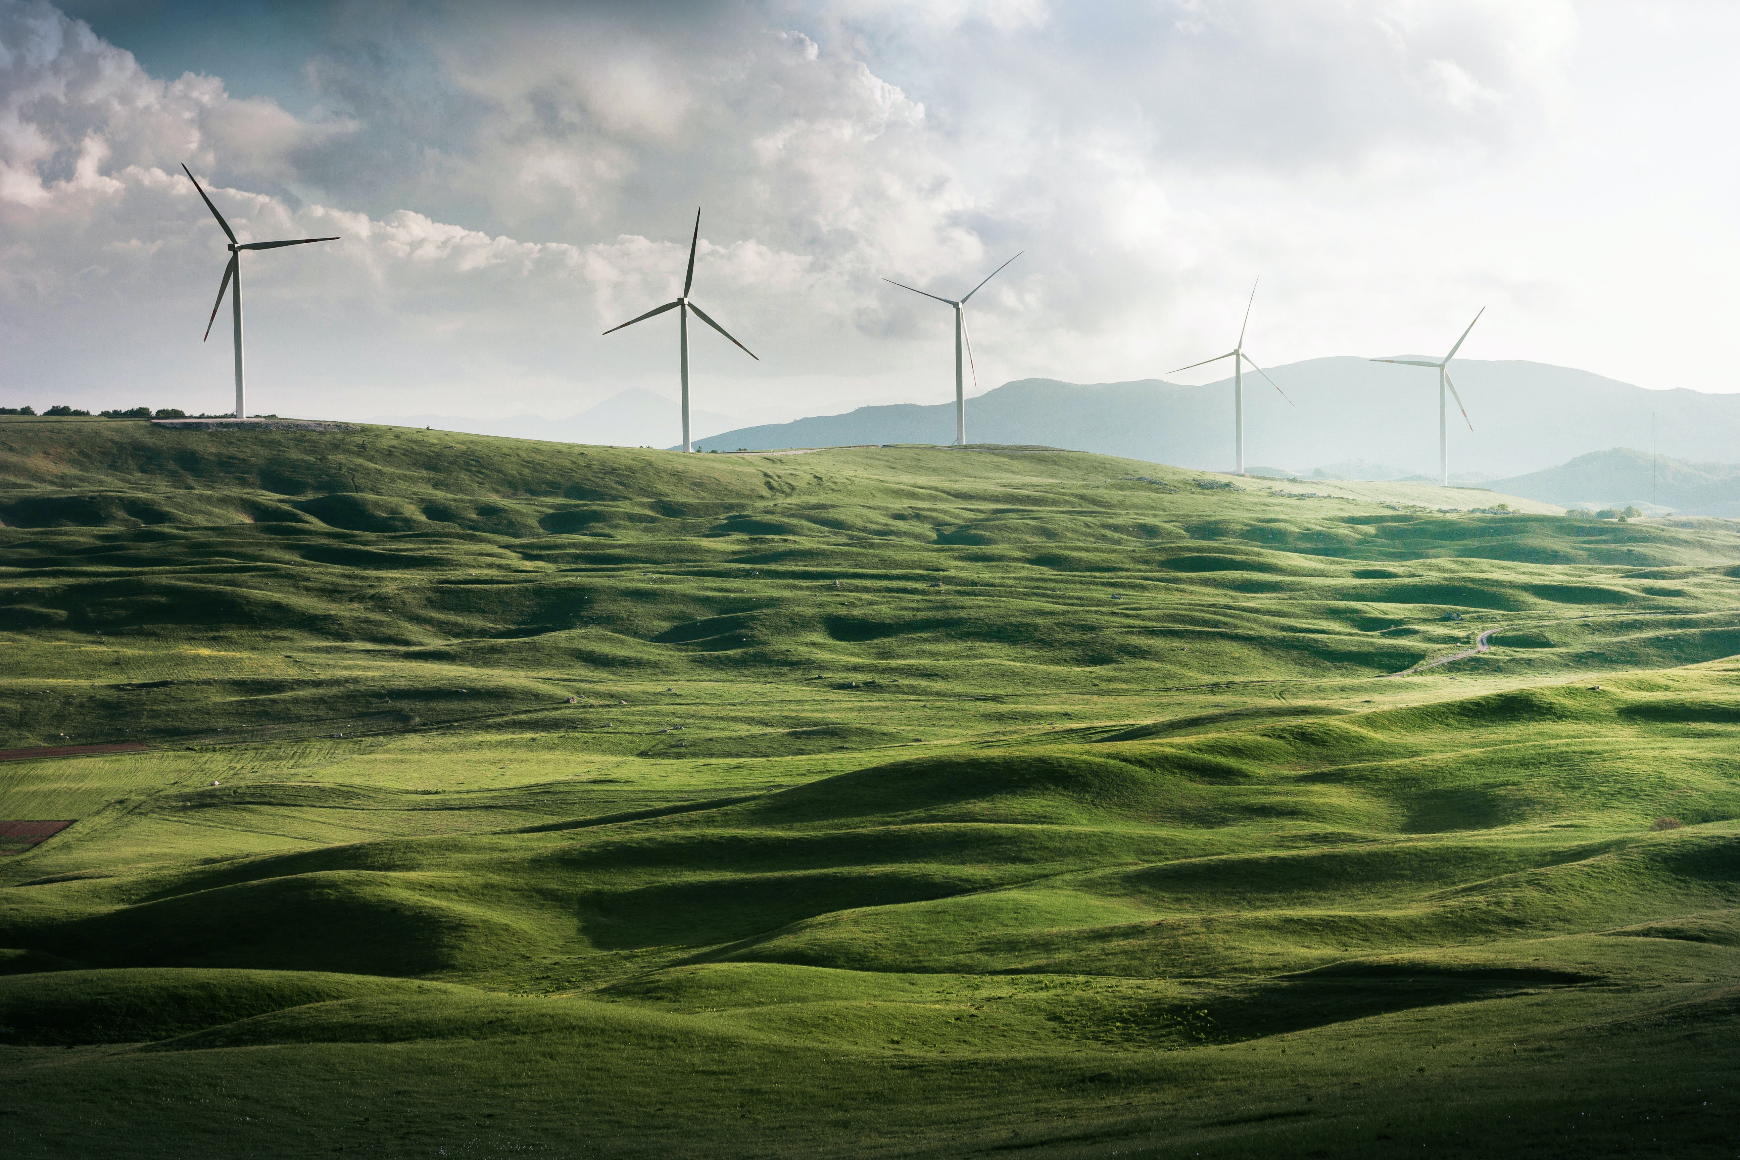
What is Sustainability?
Sustainable Development:
  the ability to provide for current generations without compromising the ability of future generations to meet their own needs.
Sustainability focuses on three key themes:
  1. Depletion of resources
  2. Climate
  3. Growth

Slide 4
Life Cycle Assessment (LCA)
Definition:
  An examination of the impact of a product on the environment throughout its life.
An LCA will measure the impact of product throughout its lifestyle from cradle to grave. This includes:
  - The extraction and processing of raw materials
  - Manufacturing and packaging the product
  - Product distribution
  - Use of the product
  - How the product is disposed as the end of its lifespan

Slide 5
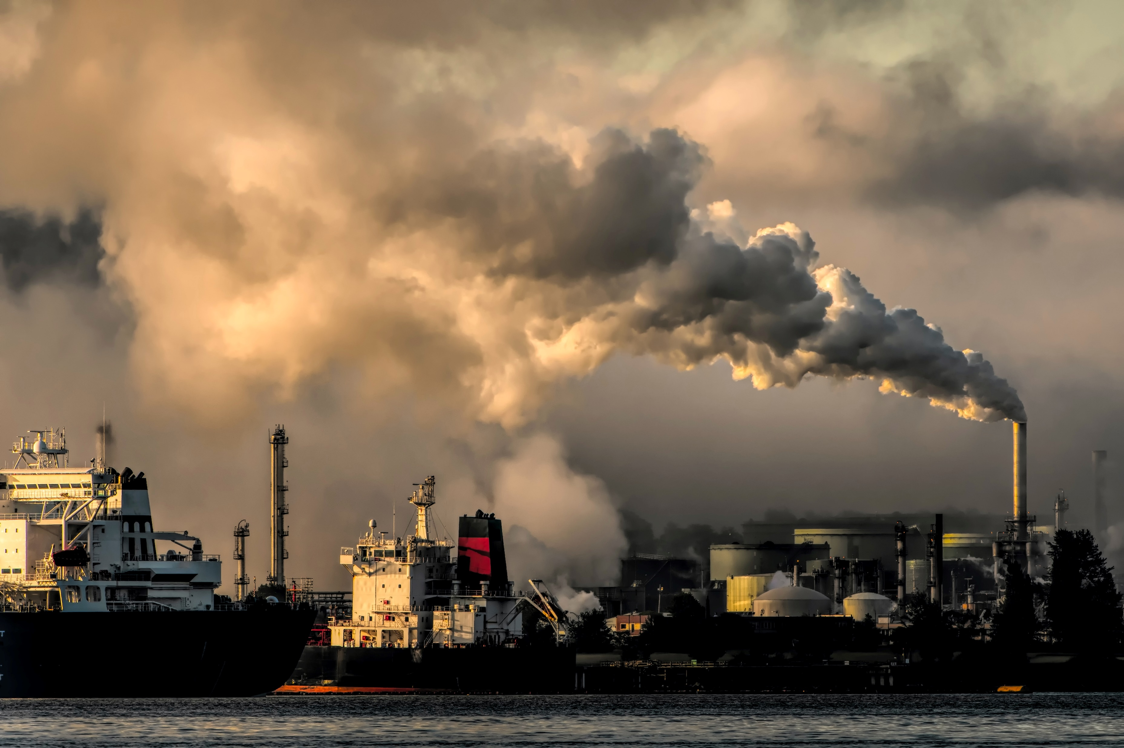
But how do you ACTUALLY measure the environmental impact of a product?

Slide 6
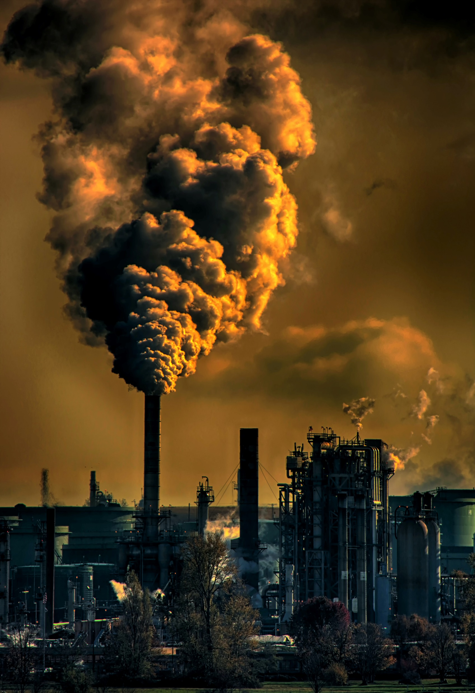
It’s difficult, right!
It can be very difficult to measure the overall environmental impact of a product across its lifetime.
It is important to define the scope of the LCA, otherwise you could go on forever!
The amount of water, resources, energy sources and production of some wastes can be easily quantified. HOWEVER, pollutant effects of greenhouse gases and other potentially toxic emissions are very difficult to accurately quantify.
The impact of emissions are calculated using best guess estimates called potentials e.g. the environmental impact of greenhouse gasses can be represented using a global warming potential (GWP).

Slide 7

LCA Class Example

Slide 8
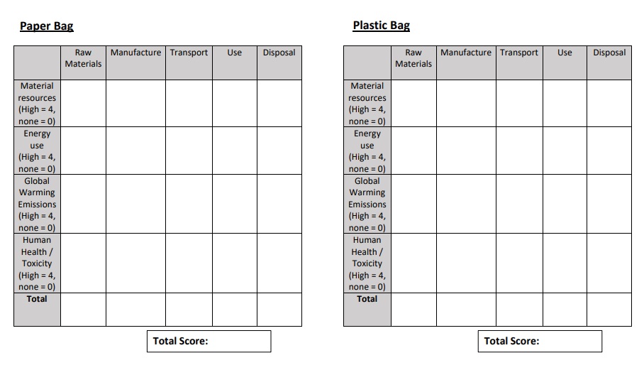
LCA Class Example

Slide 9
LCA Class Example – Key Points 1
Trees are required to manufacture paper bags, whereas crude oil is required to make plastic bags. Trees are more sustainable, but to be truly sustainable a robust replanting plan is required. Cutting down trees will also lead to the destruction of habitat.
Fractional distillation, cracking and polymerisation of crude oil to produce plastic is very energy intensive and will therefore produce a lot of emissions.
A lot of water is required to manufacture paper bags as well as the use of harmful chemicals to bleach the paper. If these chemicals leak into drinking water this will have big impact on human health.
Compared to plastic bags, paper bags are heavier and take up a greater volume, resulting in more emissions during transportation.

Slide 10
LCA Class Example – Key Points 2
Paper bags will rot if sent to landfill thus releasing greenhouse gases, especially methane. If incinerated CO2 will be released, however the incineration could be used to produce energy.
If plastic bags are sent to landfill they will not decompose, thus not producing any emissions. The incineration of a plastic bag will lead to a lot of potentially harmful emissions.
The recycling of paper or plastic bags will both require energy and transportation, thus resulting in emissions.

Slide 11
What total score did you get?

Slide 12
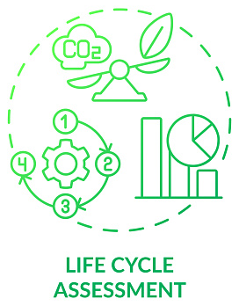
LCA Drawbacks
You all probably got very different numbers! This is the issue with Life Cycle Assessments.
The scores given to certain categories are down to personal judgement. As seen in the example just completed, many people can create an LCA for the same product and get very different answer.
Therefore, this LCA method is not very reliable.
Companies can get LCAs to make them appear environmentally friendly to gain support for their product, where in fact a lot could be done to reduce emissions!

Slide 13
How would you reduce the LCA score?

Slide 14
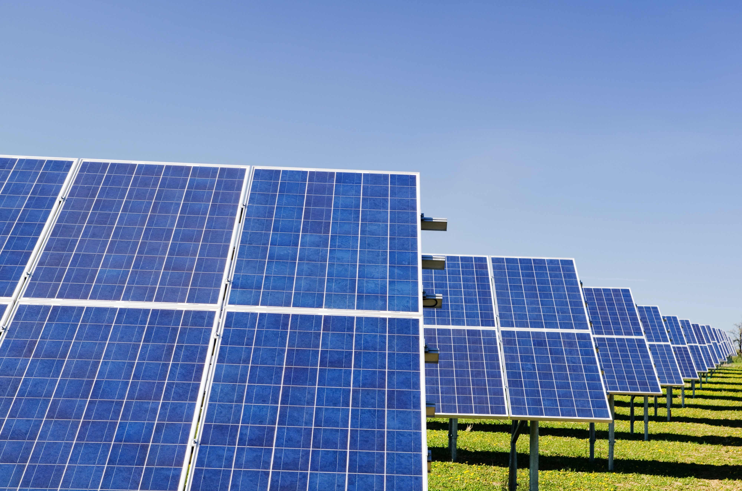
Reducing the environmental impact
Remember we talked about sustainability, this is a key concept to keep in mind when trying to reduce the environmental impact of a lifecycle.
Possible ways to reduce the environmental impact:
  Reduce the amount of raw material required.
  Decrease the processing requirement of raw materials.
  Ensure renewable energy sources are used throughout the lifecycle.
  Design products so the parts can be recycled at the end of the lifecycle.
  Use more sustainable methods of transportation.

Slide 15

This is where a Chemical Engineer is very valuable!

Slide 16
How could a Chemical Engineer help?
Chemical Engineers are often tasked with improving the energy efficiency of a system.
An LCA is no different!
If more efficient methods of manufacturing, material extraction and transportation can be used, less energy is needed, and therefore this will often lead to a lower environmental impact.
Switching to renewable energy sources will reduce the emissions produced from a process, therefore again lowering the environmental impact.

Slide 17
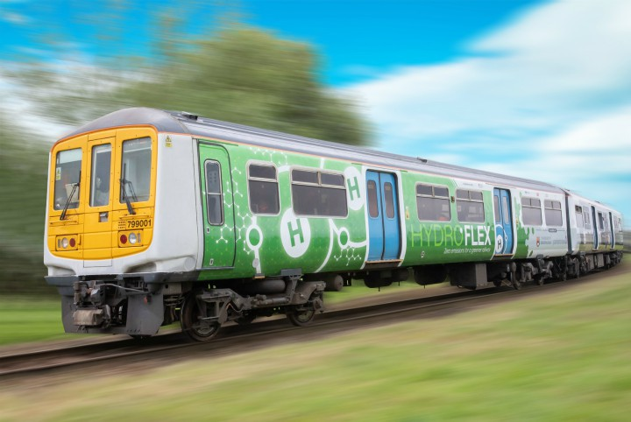
What are we doing at Birmingham?
Trying to introduce more sustainable transport options, through the use of fuel cells and hydrogen power:
    First public hydrogen filling station in the UK
    Designed and built the UK’s first practical hydrogen powered train
    Designed and built a hydrogen powered canal boat to demonstrate the potential for hydrogen to be used in maritime transport. Using hydrogen propelled boats will greatly improve the air and water quality
    Improving the efficiency and viability of hydrogen powered cars

Slide 18
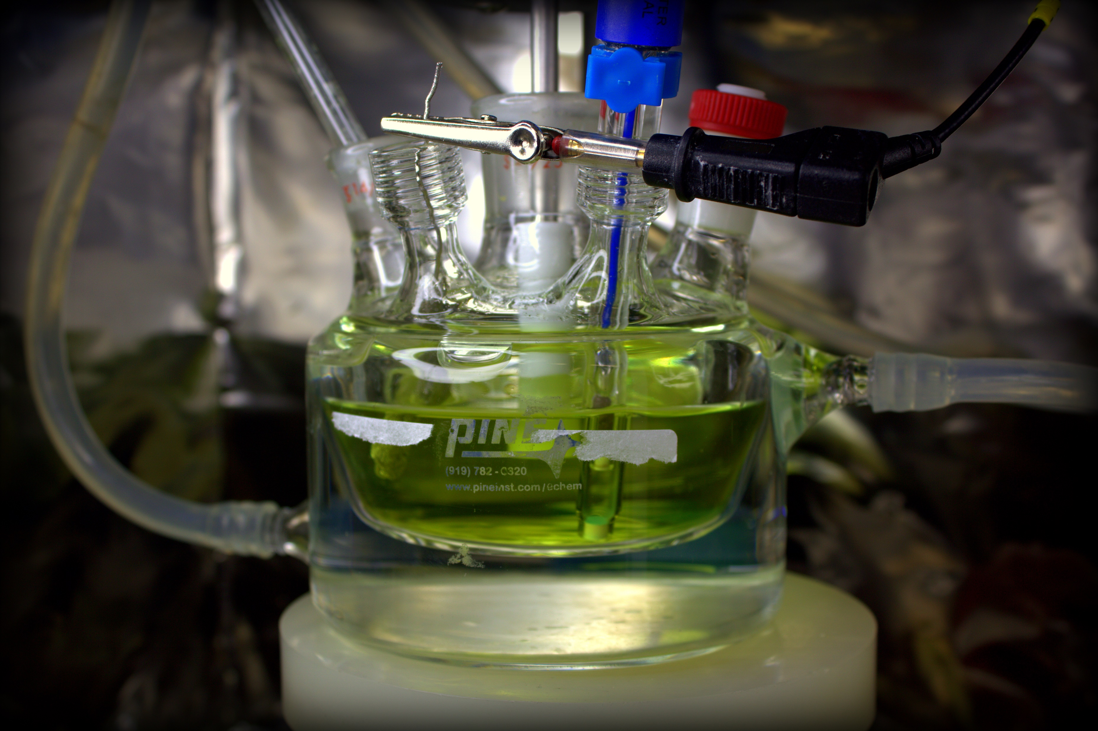
What are we doing at Birmingham?
Improving the efficiency of renewable energy options:
  Discovering methods to turn waste into energy
  Thermo-catalytic reforming (TCR) produces renewable liquid fuels from waste biomass that can directly replace fossil fuels
  Research into turning synthetic fuels and green hydrogen from organic waste biomass
Research into new catalysts and processing technologies will further improve the efficiency and reduce the environmental impact of a product / process lifetime

Slide 19
What is Sustainability?
5 minute activity – create a sustainability mind map
On the blank half of your A3 piece of paper, makes a new sustainability mind map
Compare this second mind map, with the first. Has your knowledge on sustainability changed?
Sustainability

Slide 20
Summary
It is key to keep sustainability in mind when considering all parts of the lifecycle of a product
A life cycle assessment (LCA) is used to examine the impact of a product on the environment throughout its lifetime
An LCA is very open to personal judgement, so can be twisted for marketing purposes
The environmental impact of a product can be reduced if more energy efficient processing methods are used and renewable energy sources are utilised

Slide 21



